Slide 1
CS2040S Tutorial 4

Slide 2
Admin matters
Attendance taking
Check in and PS4 discussion

Slide 3
Recap (adapted from Christian's Slides)
Trees

Slide 4
Quickselect

Slide 5
Quickselect
An algorithm to select the k^{th} smallest element in unsorted array
Derives a similar idea from Quicksort
Observation: When you finish partitioning, the pivot is already at the correct place!
But instead of recursing on both sides, recurse on one side!

Slide 6

select(4)
Initialisation. Want to select 4th smallest elem. Use 1-indexing because easier to think about
10
14
35
32
40
22
7
6
8
1
0
5
Index:
1
2
3
4
5
6
7
8
9
10
11
12

Slide 7
select(4)
Select a random pivot and partition
10
14
35
32
40
22
7
6
8
1
0
5
Index:
1
2
3
4
5
6
7
8
9
10
11
12

Slide 8
select(4)
Select a random pivot and partition
10
14
7
0
5
1
8
6
22
35
32
40
Index:
1
2
3
4
5
6
7
8
9
10
11
12

Slide 9
select(4)
We know that our pivot is actually the 9th smallest element (i.e. we are too high up!)
10
14
7
0
5
1
8
6
22
35
32
40
Index:
1
2
3
4
5
6
7
8
9
10
11
12

Slide 10
select(4)
So we recurse on the left side instead. All while choosing a new pivot
10
14
7
0
5
1
8
6
22
32
40
6
35
Index:
1
2
3
4
5
6
7
8
9
10
11
12

Slide 11
select(4)
Partitioning…
1
0
5
7
6
14
10
6
22
32
40
8
35
Index:
1
2
3
4
5
6
7
8
9
10
11
12

Slide 12
select(4)
Our pivot 5 was actually the 3rd smallest element. Too low!
1
0
5
7
6
14
10
6
22
32
40
8
35
Index:
1
2
3
4
5
6
7
8
9
10
11
12

Slide 13
select(4)
Recurse to the right, and so on!
1
0
5
7
6
14
10
6
22
32
40
8
35
Index:
1
2
3
4
5
6
7
8
9
10
11
12
It is more important to understand the idea behind quickselect rather than being caught up in the indexing issues.

Slide 14
Quickselect Analysis
For an array of size n...
Recurrence Relation:
Time Complexity:

Slide 15
Quickselect Analysis
For an array of size n...
Recurrence Relation: T(n) = T(n / 2) + O(n)
Time Complexity: O(n)

Slide 16
Ordered Dictionary ADT
It should guarantee these operations:
Notes:
abstract data type (ADT) is a mathematical model for data types. ... Formally, an ADT may be defined as a "class of objects whose logical behavior is defined by a set of values and a set of operations"; this is analogous to an algebraic structure in mathematics.

Slide 17
Ordered Dictionary ADT
It should guarantee these operations:
insert(key, value)
search(key)
delete(key)
contains(key)
successor(key)
predecessor(key)
size()

Slide 18
Binary trees
x
BT or empty tree
BT or empty tree
Left subtree
Right subtree

Slide 19
Binary trees
Conceptually, we often visually represent a binary tree in the following form
x
Root node containing the node’s key x
We call this a node in the tree
BT or empty tree
BT or empty tree
Left subtree
Right subtree
Realize that this diagram applies to EVERY NODE in the BT?
I.E. every node in the BT is itself the root node of a BT!

Slide 20
Height of a node
Definition: Number of edges on the longest path from from node to leaf

Slide 21
Height of a node
Definition: Number of edges on the longest path from from node to leaf
For this node, which is the longest path to leaf?
6
3
8
2
5
9
7

Slide 22
Height of a node
Definition: Number of edges on the longest path from from node to leaf
For this node, which is the longest path to leaf?
6
3
8
2
5
9
7

Slide 23
Height of a node
Definition: Number of edges on the longest path from node to leaf
For this node, which is the longest path to leaf?
6
How many edges are there in that path?
3
8
2
5
9
7

Slide 24
Height of a node
Definition: Number of edges on the longest path from from node to leaf
For this node, which is the longest path to leaf?
6
How many edges are there in that path?
3
Therefore this node has height 3
3
8
2
5
9
7

Slide 25
Height of a node
Definition: Number of edges on the longest path from from node to leaf
What’s the height of this node?
6
3
8
2
5
9
7

Slide 26
Height of a node
Definition: Number of edges on the longest path from from node to leaf
What’s the height of this node?
6
3
8
2
5
9
7

Slide 27
Depth of a node
Definition: Number of edges to the root

Slide 28
Depth of a node
Definition: Number of edges to the root
6
3
8
2
5
9
7

Slide 29
Depth of a node
Definition: Number of edges to the root
For this node, how many edges are needed to go up to the root?
6
3
8
2
5
9
7

Slide 30
Depth of a node
Definition: Number of edges to the root
For this node, how many edges are needed to go up to the root?
3
6
3
8
2
5
9
7

Slide 31
Depth of a node
Definition: Number of edges to the root
For this node, how many edges are needed to go up to the root?
6
3
8
2
5
9
7

Slide 32
Depth of a node
Definition: Number of edges to the root
For this node, how many edges are needed to go up to the root?
6
3
8
2
5
9
7

Slide 33
Binary Search Trees (BST)

Slide 34
Binary Search Trees (BST)
It is a binary tree with the following properties:
A node’s left subtree contains nodes strictly less than the node’s key
A node’s right subtree contains nodes strictly greater than the node’s key
The left and right subtrees are binary trees
All keys belong to a total order (no two different keys can be considered equal)

Slide 35
Binary Search Trees (BST)
It is a binary tree with the following properties:
A node’s left subtree contains nodes strictly less than the node’s key
A node’s right subtree contains nodes strictly greater than the node’s key
The left and right subtrees are binary trees
All keys belong to a total order (no two different keys can be considered equal)
Common mistake: Thinking that only the direct left/right child have to be less/greater. It is ALL the nodes in the left/right SUBTREE

Slide 36
Binary Search Trees (BST)
x
<x
>x

Slide 37
Is this a BST?
6
3
8
2
5
9
7
Question 1
Fun fact: There used to be CS2020, which is essentially a 6MC version of CS2030 + CS2040S in one mod

Slide 38
Is this a BST?
6
3
8
2
5
9
7
Question 1
NO! Compare these two nodes and notice that 7 belongs to the right subtree of 8

Slide 39
Is this a BST?
6
3
8
2
5
9
7
Question 1
If you were to (wrongly) use the idea that only the direct left/right childs have to be smaller/greater, then this fits. BUT THIS IS NOT A BST

Slide 40
Is this a BST?
6
3
8
2
5
9
Question 2
Fun fact: Tony Hoare invented Quicksort at the age of 26 when he was a visiting student

Slide 41

Is this a BST?
6
3
8
2
5
9
Question 2
Yes! Everything is gud

Slide 42
Is this a BST?
6
3
8
2
5
9
2
3
5
6
8
9
#LIFEHACKS
If you “drop” every node and it appears like a sorted sequence, then it is a BST

Slide 43
Is this a BST?
5
2
3
1
4
9
Question 3
Fun fact: Prof Seth Gilbert proved an important theorem called CAP theorem

Slide 44
Is this a BST?
5
2
3
1
4
9
Question 3
Nope! Either use the “dropping” method or observe that 3 is in the right subtree of 5

Slide 45
Is this a BST?
3
2
1
Question 4
Fun fact: Donald Knuth, the “father of analysis of algorithms” is still writing a book called The Art Of Computer Programming since 1968

Slide 46
Is this a BST?
3
2
1
Question 4
Yeboi

Slide 47

Is this a BST?
3
Question 5
Fun fact: COM3 which is being built, is the first building that is built for SoC (we inherited COM1 and COM2 from Law i think)

Slide 48
Is this a BST?
3
Question 5
This lonely boi is also a BST!
(You can think of the left and right childs being empty trees)

Slide 49
Summary
h(v) - height of a node: Number of edges on the longest path from node to leaf.
h(v) = 0 (if v is a leaf)
h(v) = max(h(v.left), h(v.right)) + 1

Slide 50
Questions?

Slide 51
Operations in a BST
Searching
Insertion
Search Minimum and Maximum
Successor and Predecessor
Delete
Traversal

Slide 52
Operations in a BST
Searching
Insertion
Search Minimum and Maximum
Successor and Predecessor
Delete
Traversal

Slide 53
Searching
Idea:
Compare root vs element you are looking for
If element == root, found!
Else if element < root, recurse to the left subtree
Else element > root, recurse to the right subtree

Slide 54
Searching
search(144)
Initialisation
34
5
233
2
13
89
610
1
3
8
21
55
144
377
987

Slide 55
Searching
search(144)
Compare 144 with 34
34
5
233
2
13
89
610
1
3
8
21
55
144
377
987

Slide 56
Searching
search(144)
144 is greater than 34. Since we are in BST, we are guaranteed that 144 cannot be in the left subtree
34
5
233
2
13
89
610
1
3
8
21
55
144
377
987

Slide 57
Searching
search(144)
Compare 144 with 233
34
5
233
2
13
89
610
1
3
8
21
55
144
377
987

Slide 58
Searching
search(144)
144 is less than 233. We can ignore the right subtree
34
5
233
2
13
89
610
1
3
8
21
55
144
377
987

Slide 59
Searching
search(144)
Compare 144 with 89
34
5
233
2
13
89
610
1
3
8
21
55
144
377
987

Slide 60
Searching
search(144)
144 is greater than 89 so we can ignore the left subtree
34
5
233
2
13
89
610
1
3
8
21
55
144
377
987

Slide 61
Searching
search(144)
Compare 144 with 144, and found!
34
5
233
2
13
89
610
1
3
8
21
55
144
377
987

Slide 62
Searching (eg2)
search(145)
If for example we are searching for 145 instead of 144. Notice that everything is the same up to this point
34
5
233
2
13
89
610
1
3
8
21
55
144
377
987

Slide 63
Searching
Searching (eg2)
search(145)
145 is greater than 89 so we can ignore the left subtree
34
5
233
2
13
89
610
1
3
8
21
55
144
377
987

Slide 64
Searching
Searching (eg2)
search(145)
Compare 145 with 144
34
5
233
2
13
89
610
1
3
8
21
55
144
377
987

Slide 65
Searching
Searching (eg2)
search(145)
We are supposed to explore the right subtree, but 144 does not have a right subtree!
We can report ‘not found’
34
5
233
2
13
89
610
1
3
8
21
55
144
377
987

Slide 66
Searching
Searching (eg3)
search(987)
Initialisation
8
21
55
144
377
987

Slide 67
Searching
Searching (eg3)
search(987)
Compare 987 with 8
8
21
55
144
377
987

Slide 68
Searching
Searching (eg3)
search(987)
987 cannot be in the left subtree. So we explore the right subtree
8
21
55
144
377
987

Slide 69
Searching
Searching (eg3)
search(987)
Compare 987 with 21
8
21
55
144
377
987

Slide 70
Searching
Searching (eg3)
search(987)
Also the same thing. Go right!
8
21
55
144
377
987

Slide 71
Searching
Searching (eg3)
search(987)
and so on...
8
21
55
144
377
987

Slide 72
Searching
Searching (eg3)
search(987)
will spare you the agony of going through several slides xD
8
21
55
144
377
987

Slide 73
Searchmin and Searchmax
Where are the smallest and largest elements located in the tree?
34
5
233
2
13
89
610
1
3
8
21
55
144
377
987

Slide 74
Searchmin and Searchmax
Where are the smallest and largest elements located in the tree?
34
5
233
2
13
89
610
1
3
8
21
55
144
377
987

Slide 75
Searchmin and Searchmax
Where are the smallest and largest elements located in the tree?
34
5
233
2
13
89
610
Leftmost of the tree
1
3
8
21
55
144
377
987
Rightmost of the tree

Slide 76

Searchmin and Searchmax
The idea:
Just keep going down the left subtree (for min) or the right subtree (for max) ‘til you can’t no more

Slide 77
Questions?

Slide 78
Successor and Predecessor

Slide 79
Successor and Predecessor
The successor of key x is basically the “next bigger key” in the tree
The predecessor of key x is basically the “previous smaller key” in the tree

Slide 80
Successor and Predecessor
The successor of key x is basically the “next bigger key” in the tree
The predecessor of key x is basically the “previous smaller key” in the tree
Another way to think about it: If you perform an in-order traversal (“write the keys in sorted order”), the successor is the next one in the sorted sequence and the predecessor is the previous one in the sorted sequence*
*If the key doesn’t exist in the tree, pretend you have inserted it in the sorted order for visualisation

Slide 81
Successor (Case 1)
successor(34)
Who is the successor of 34?
34
5
233
2
13
89
610
1
3
8
21
55
144
377
987

Slide 82
Successor (Case 1)
successor(34)
It’s 55!
34
5
233
2
13
89
610
1
3
8
21
55
144
377
987

Slide 83
Successor (Case 1)
successor(34)
Do you notice something about where 55 is located?
34
5
233
2
13
89
610
1
3
8
21
55
144
377
987

Slide 84
Successor (Case 1)
successor(34)
It’s the smallest element of 34’s right subtree!
34
5
233
2
13
89
610
1
3
8
21
55
144
377
987

Slide 85
Successor (Case 2)
successor(21)
What if the node doesn’t have a right subtree like this node with key 21 here?
First, what is this node’s successor?
34
5
233
2
13
89
610
1
3
8
21
55
144
377
987

Slide 86
Successor (Case 2)
successor(21)
34 is the successor. How did we get to 34?
34
5
233
2
13
89
610
1
3
8
21
55
144
377
987

Slide 87
Successor (Case 2)
successor(21)
Essentially, keep going up the tree until we have to “climb to the right”
34
5
233
2
13
89
610
1
3
8
21
55
144
377
987

Slide 88
Successor (Case 2)
successor
Verify that this pattern holds for other cases
34
5
233
2
13
89
610
1
3
8
21
55
377
987

Slide 89
Questions?

Slide 90
Insert
The idea:

Slide 91
Insert
The idea:
Keep going as if you are “searching”
Once you cannot go on anymore (because you need to go to the right/left subtree but the right/left subtree is empty), you have found the position to insert

Slide 92
Insert
insert(155)
Initialisation
34
5
233
2
13
89
610
1
3
8
21
55
144
377
987

Slide 93
Insert
insert(155)
Go to the right subtree
34
34
5
233
2
13
89
610
1
3
8
21
55
144
377
987

Slide 94
Insert
insert(155)
Same deal for the most part
34
5
233
2
13
89
610
1
3
8
21
55
144
377
987

Slide 95
Insert
insert(155)
Now you are supposed to go to the right subtree, but it’s empty! So that’s where you insert
34
5
233
2
13
89
610
144
1
3
8
21
55
377
987
155
Space issues lulz

Slide 96
Questions?

Slide 97
Distinct Binary Trees
Different insertion order can produce different shapes of binary trees
Let’s say we are interested in the different shapes of binary trees
Given n nodes, how many distinct binary trees are there?
We can count recursively

Slide 98
n = 0
We count empty tree as a single “shape”.
#NothingIsSomething
# nodes | # shapes
0 | 1

Slide 99
n = 1
Only one lonely boi possible
# nodes | # shapes
0 | 1
1 | 1

Slide 100
n = 2
Still brute force-able
# nodes | # shapes
0 | 1
1 | 1
2 | 2

Slide 101
n = 3
Also still somewhat brute force-able
# nodes | # shapes
0 | 1
1 | 1
2 | 2
3 | 5

Slide 102
n = 4
Probably not so nice to brute force it… Let’s try to do it more cleverly!
# nodes | # shapes
0 | 1
1 | 1
2 | 2
3 | 5

Slide 103
n = 4
Idea: Let’s fix the root node. What are the possibilities regarding the number of nodes in the left and right subtree?
# nodes | # shapes
0 | 1
1 | 1
2 | 2
3 | 5
x nodes
y nodes
Left subtree
Right subtree

Slide 104
n = 4
This is one possibility...
# nodes | # shapes
0 | 1
1 | 1
2 | 2
3 | 5
4
0 node
3 nodes
Left subtree
Right subtree

Slide 105
n = 4
This is another one
# nodes | # shapes
0 | 1
1 | 1
2 | 2
3 | 5
4
1 node
2 nodes
Left subtree
Right subtree

Slide 106
n = 4
Let’s try counting how many trees can there be of this particular “shape”
# nodes | # shapes
0 | 1
1 | 1
2 | 2
3 | 5
4
0 node
3 nodes
Left subtree
Right subtree

Slide 107
n = 4
Use your permutations and combinations: 1 * 5
# nodes | # shapes
0 | 1
1 | 1
2 | 2
3 | 5
4
0 node
3 nodes
Left subtree
Right subtree

Slide 108
n = 4
In total, there can be 0 & 3, 1 & 2, 2 & 1, 3 & 0 nodes in the left & right subtree respectively.
Let’s add this all up!
# nodes | # shapes
0 | 1
1 | 1
2 | 2
3 | 5
4
x nodes
y nodes
Left subtree
Right subtree

Slide 109
n = 4
(1 * 5)
# nodes | # shapes
0 | 1
1 | 1
2 | 2
3 | 5
4
0 node
3 nodes
Left subtree
Right subtree

Slide 110
n = 4
(1 * 5) + (1 * 2)
# nodes | # shapes
0 | 1
1 | 1
2 | 2
3 | 5
4
1 nodes
2 nodes
Left subtree
Right subtree

Slide 111
n = 4
(1 * 5) + (1 * 2) + (2 * 1)
# nodes | # shapes
0 | 1
1 | 1
2 | 2
3 | 5
4
2 nodes
1 node
Left subtree
Right subtree

Slide 112
n = 4
(1 * 5) + (1 * 2) + (2 * 1) + (5 * 1)
# nodes | # shapes
0 | 1
1 | 1
2 | 2
3 | 5
4
3 nodes
0 node
Left subtree
Right subtree

Slide 113
n = 4
(1 * 5) + (1 * 2) + (2 * 1) + (5 * 1)
# nodes | # shapes
0 | 1
1 | 1
2 | 2
3 | 5
4
x nodes
y nodes
Left subtree
Right subtree

Slide 114
n = 4
(5) + (2) + (2) + (5) = 14
# nodes | # shapes
0 | 1
1 | 1
2 | 2
3 | 5
4 | 14
x nodes
y nodes
Left subtree
Right subtree

Slide 115
n = 5
As an exercise, verify that for n = 5, the number of distinct shapes is 42
# nodes | # shapes
0 | 1
1 | 1
2 | 2
3 | 5
4 | 14
x nodes
y nodes
Left subtree
Right subtree

Slide 116
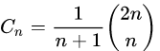
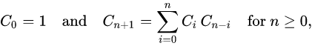
Catalan Numbers
You have just counted the Catalan Numbers!
# nodes | # shapes
0 | 1
1 | 1
2 | 2
3 | 5
4 | 14
Catalan Numbers:
x nodes
y nodes
Recursive formula used:
Left subtree
Right subtree
Read more about counting shapes of binary trees here

Slide 117
Questions?

Slide 118
Deletion
A data structure is not interesting if we cannot remove anything from it! We need to be able to perform deletions:
There are multiple cases for deletion with respect to the target node to delete:
Node is not found
Node is at leaf
Node is an internal node with 1 child
Node is an internal node with 2 children
Note: The examples of binary trees in the following slides will differ by case for convenience in demonstration

Slide 119
Delete (Case 1)
delete(40)
Initialisation
[Node not found]
34
5
233
2
13
610
1
3
8
21
377
987

Slide 120
Delete (Case 1)
delete(40)
Compare 40 with 34
[Node not found]
34
5
233
2
13
610
1
3
8
21
377
987

Slide 121
Delete (Case 1)
delete(40)
We go right!
[Node not found]
34
5
233
2
13
610
1
3
8
21
377
987

Slide 122
Delete (Case 1)
delete(40)
40 is less than 233. But the left subtree is empty so it must mean that 40 does not exist. Do nothing!
[Node not found]
34
5
233
2
13
610
1
3
8
21
377
987

Slide 123
Delete (Case 2)
delete(610)
Initialisation
[Node is at a leaf]
34
5
233
2
13
610

Slide 124
Delete (Case 2)
delete(610)
I’ll skip the “searching” step :P
Let’s say we have traversed all the way to the right and found the node. wat do now
[Node is at a leaf]
34
5
233
2
13
610

Slide 125
Delete (Case 2)
delete(610)
Just remove! Nothing wrong because it doesn’t break the BST property
[Node is at a leaf]
34
5
233
2
13
610

Slide 126
Delete (Case 3)
delete(233)
Initialisation
[Node has 1 child]
34
5
233
2
13
610

Slide 127
Delete (Case 3)
delete(233)
Gonna skip the “searching” again. Now if you directly remove this node, there will be orphans :O wat to do
[Node has 1 child]
34
Child, I am sorry…
5
233
Father don’t go!!
2
13
610

Slide 128
Delete (Case 3)
delete(233)
Let the grandpa adopt the poor child!
[Node has 1 child]
No, I am your father!
34
5
233
2
13
610

Slide 129
Delete (Case 4)
delete(5)
Initialisation
[Node has 2 children]
34
5
233
2
13
610
1
21
377
987

Slide 130
Delete (Case 4)
delete(5)
Skipping the search visualisation again… If we were to delete this node directly, there will be 2 orphans!
[Node has 2 children]
34
Ma, can you adopt my two kids?
5
233
2
13
610
1
21
377
987

Slide 131
Delete (Case 4)
delete(5)
Adopting 2 children is a bit too much for the grandparent :( how how
[Node has 2 children]
soz too much responsibility
34
Ma, can you adopt my two kids?
5
233
2
13
610
1
21
377
987

Slide 132
Delete (Case 4)
delete(5)
Solution: Successor shall take over
[Node has 2 children]
34
5
233
I shall succeed you!
2
13
610
1
21
377
987

Slide 133
Delete (Case 4)
delete(5)
(Note that currently the BST property is violated. We shall fix it soon but how :O)
[Node has 2 children]
34
I shall succeed you!
13
233
2
5
610
1
21
377
987

Slide 134
Delete (Case 4)
delete(5)
Deleting 5 is just the case of deleting node with 1 children!
[Node has 2 children]
34
13
233
Goodbye world
2
5
610
1
21
377
987

Slide 135
Delete (Case 4)
delete(34)
Initialisation: Another example for the case of node with 2 children
[Node has 2 children]
34
5
233
2
13
89
144

Slide 136
Delete (Case 4)
delete(34)
Successor will take over
[Node has 2 children]
34
5
233
I shall succeed you!
2
13
89
144

Slide 137
Delete (Case 4)
delete(34)
Swap anddddd
[Node has 2 children]
89
I shall succeed you!
5
233
2
13
34
Thanks dude
144

Slide 138

Delete (Case 4)
delete(34)
it’s gone
[Node has 2 children]
89
5
233
2
13
34
144

Slide 139
Deletion: Why does replacing with successor work?
We need to maintain the following:

Slide 140
Deletion: Why does replacing with successor work?
We need to maintain the following:
BST property is not violated when we swap
Successor has at most 1 child (why?)

Slide 141
Deletion: Why does replacing with successor work?
We need to maintain the following:
BST property is not violated when we swap
Successor has at most 1 child (because if 1 child, can just let grandparent adopt the child. If no child, can simply delete)

Slide 142
Questions?

Slide 143
Traversals
Different types of traversal:
preorder:
inorder:
postorder:

Slide 144
Traversals
Different types of traversal:
preorder: print(root) traverse(left) traverse(right)
inorder: traverse(left) print(root) traverse(right)
postorder: traverse(left) traverse(right) print(root)

Slide 145
Pre-order Traversal
Lifehack: Put these “markers” at the left (pre)
34
5
233
2
13
610

Slide 146

Pre-order Traversal
Lifehack: Put these hongbaos at the left (pre)
34
5
233
2
13
610

Slide 147
Pre-order Traversal
Lifehack: Put these hongbaos at the left (pre)
34
Arrow is order of recursion tree being “unrolled”
5
233
2
13
610
Order of hongbao collection: 34 5 2 13 233 610

Slide 148
In-order Traversal
Lifehack: Put these hongbaos at the bottom (in)
34
5
233
2
13
610
Order of hongbao collection: ???

Slide 149
In-order Traversal
Lifehack: Put these hongbaos at the bottom (in)
34
5
233
2
13
610
Order of hongbao collection: 2 5 13 34 233 610

Slide 150
In-order Traversal
Lifehack: Put these hongbaos at the bottom (in)
34
5
233
2
13
610
Cool stuff: if your tree is BST, the inorder traversal appears in sorted order!
Order of hongbao collection: 2 5 13 34 233 610

Slide 151
Post-order Traversal
Lifehack: Put these hongbaos at the right (post)
34
5
233
2
13
610
Order of hongbao collection: ???

Slide 152
Post-order Traversal
Lifehack: Put these hongbaos at the right (post)
34
5
233
2
13
610
Order of hongbao collection: 2 13 5 610 233 34

Slide 153
Time to traverse?

Slide 154
Time to traverse?
Intuitively, you are going through the entire tree.
Therefore it is O(n) time

Slide 155
Time-complexity of BST operations

Slide 156
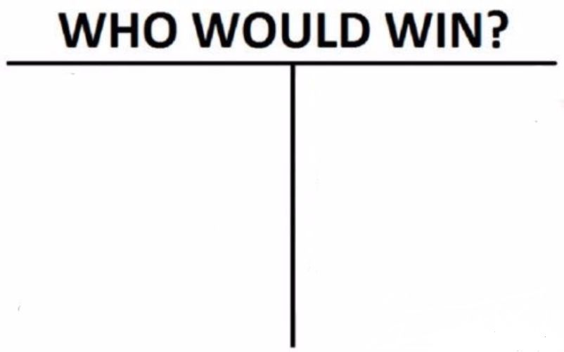
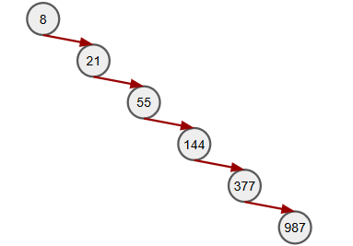
Time-complexity of BST operations
Most of these operations are O(h) time where h is the height of the BST
NOT necessarily O(logn) time where n is the number of elements in the tree
Computer Scientists who have worked hard to create a data structure that supports O(logn) search, insert, delete, successor, predecessor queries
ONE CHAINY BOI

Slide 157
Enter the AVL trees!

Slide 158
Enter the AVL trees!
Named after Adelson-Velsky and Landis (two people not three)
Idea: Since the time-complexities of most operations in BST are O(h), let’s find a way to bound h by logn!
This is the concept of height-balanced trees. AVL tree is not the only way we can achieve this. Other trees such as Red-Black trees, B-Trees, Splay Trees exist.

Slide 159
How to AVL tree
Every node contains the variable for height
height = max(left.height, right.height) + 1

Slide 160
How to AVL tree
Every node contains the variable for height
height = max(left.height, right.height) + 1
Invariant for height-balancing: For every node, the height of their children differ by at most 1.

Slide 161
How to AVL tree
Every node contains the variable for height
height = max(left.height, right.height) + 1
Invariant for height-balancing: For every node, the height of their children differ by at most 1.
If this particular invariant is broken, then the tree is not an AVL-tree anymore

Slide 162
Rotations

Slide 163
Rotations
How we achieve balance!
Different kinds: left rotate, right rotate, left-left rotate, right-right rotate
IMPORTANT: Has to preserve the BST properties!

Slide 164
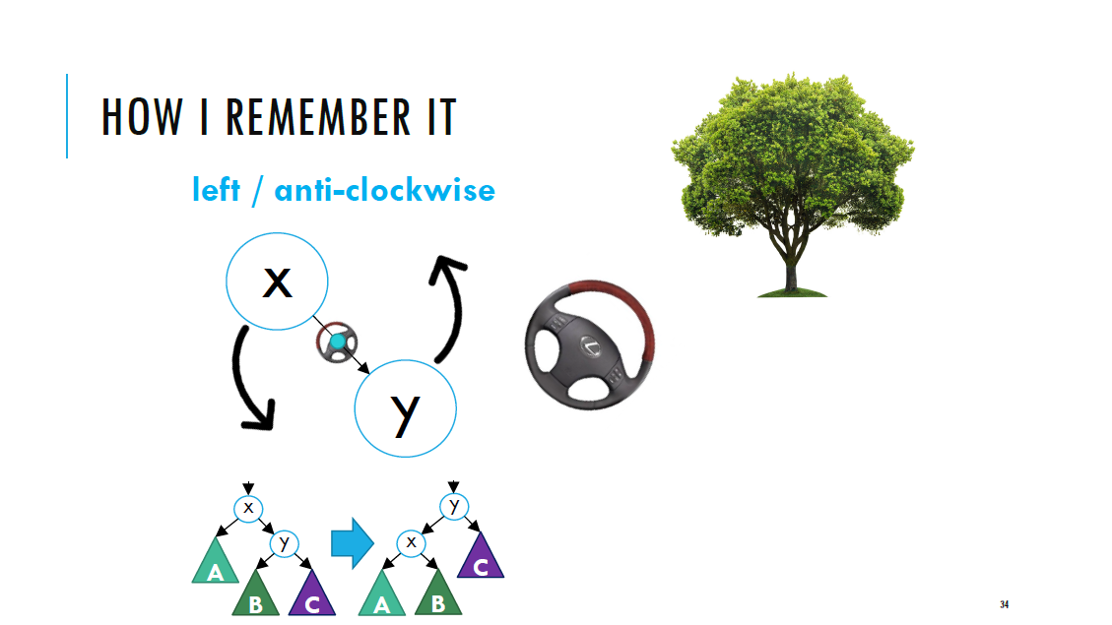
Taken from Prof Harold’s AY19/20 S1 slides (with permission)
This tree is right-heavy! Position the steering wheel like this

Slide 165
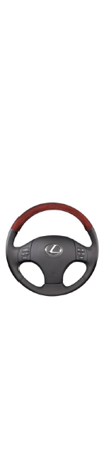
Taken from Prof Harold’s AY19/20 S1 slides (with permission)

Slide 166
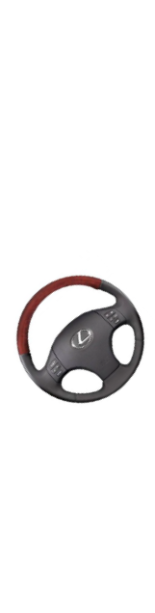
Taken from Prof Harold’s AY19/20 S1 slides (with permission)

Slide 167
Imbalanced?? How should we rotate this?
34
5
233
13
89
610
8
55
144
377
987

Slide 168
Imbalanced?? How should we rotate this?
34
5
233
The zigzag pattern creates trouble!
If you see zigzag, most likely need to double rotate
13
89
610
8
55
144
377
987

Slide 169
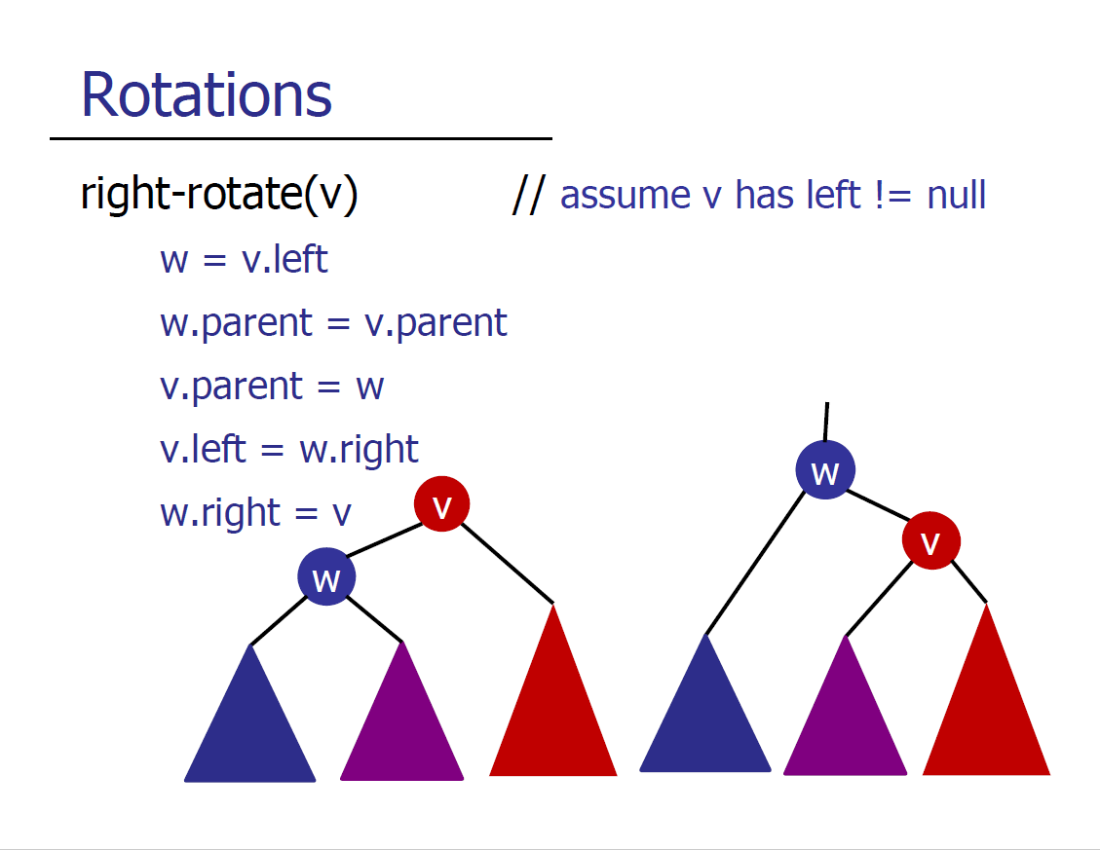

Slide 170
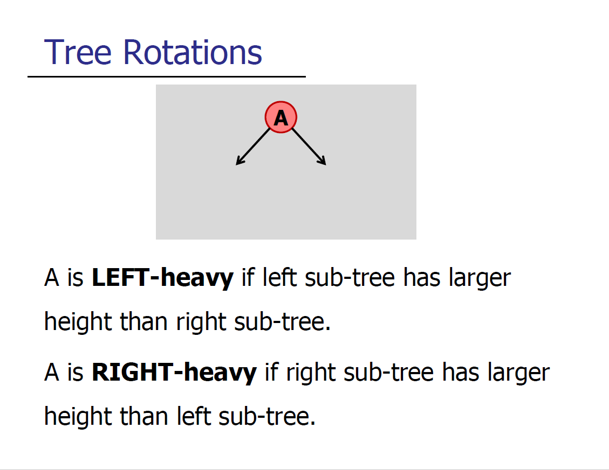

Slide 171
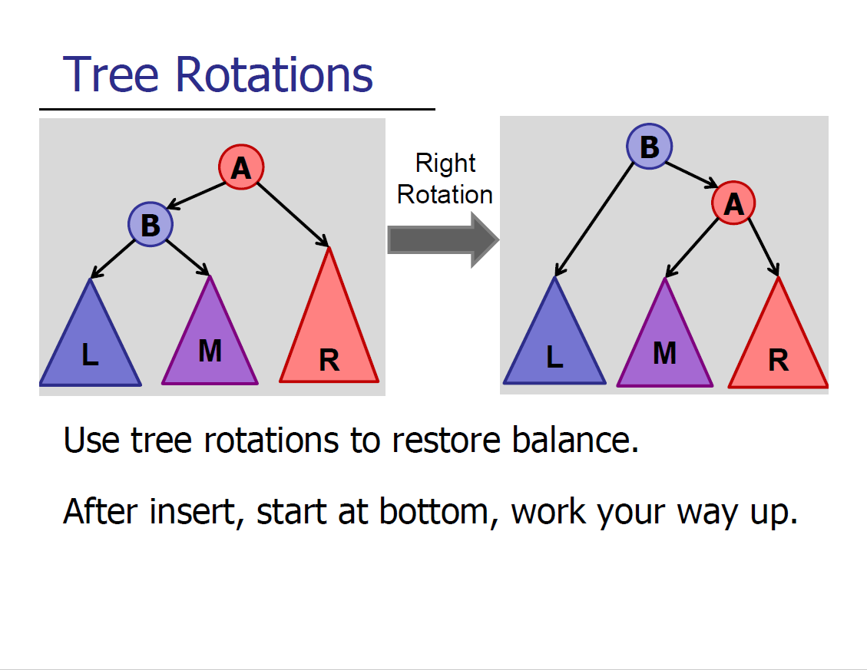

Slide 172
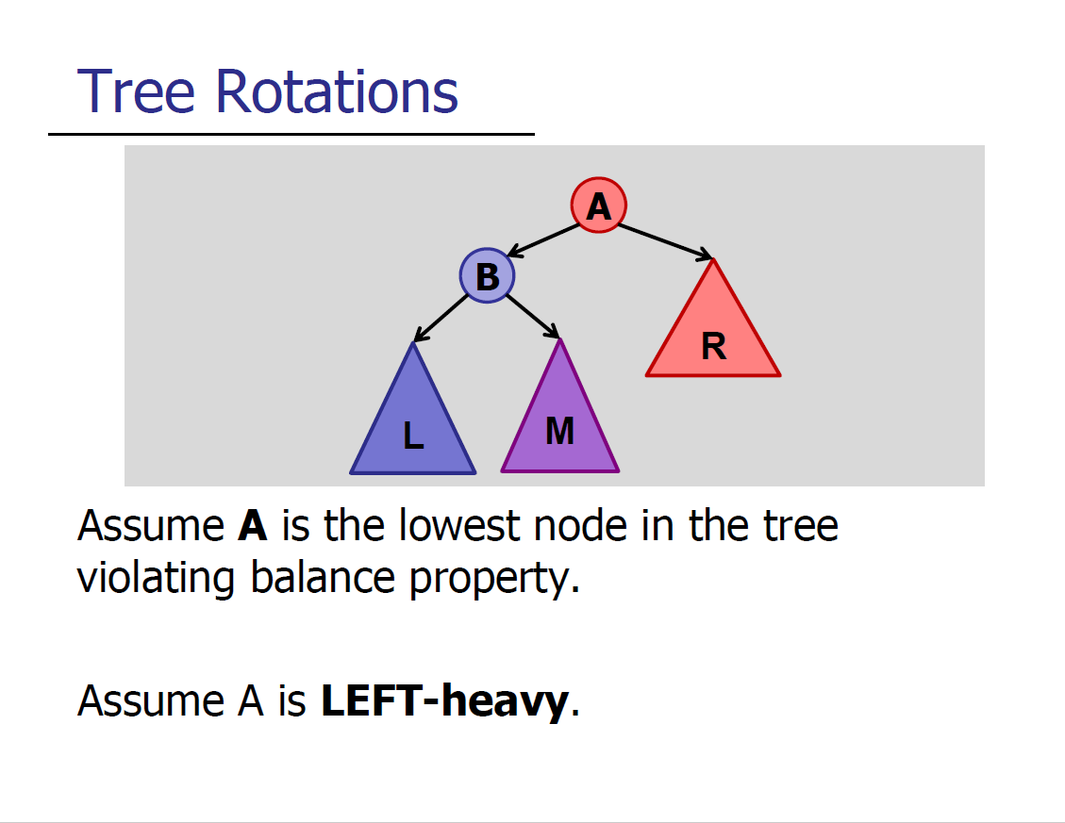

Slide 173
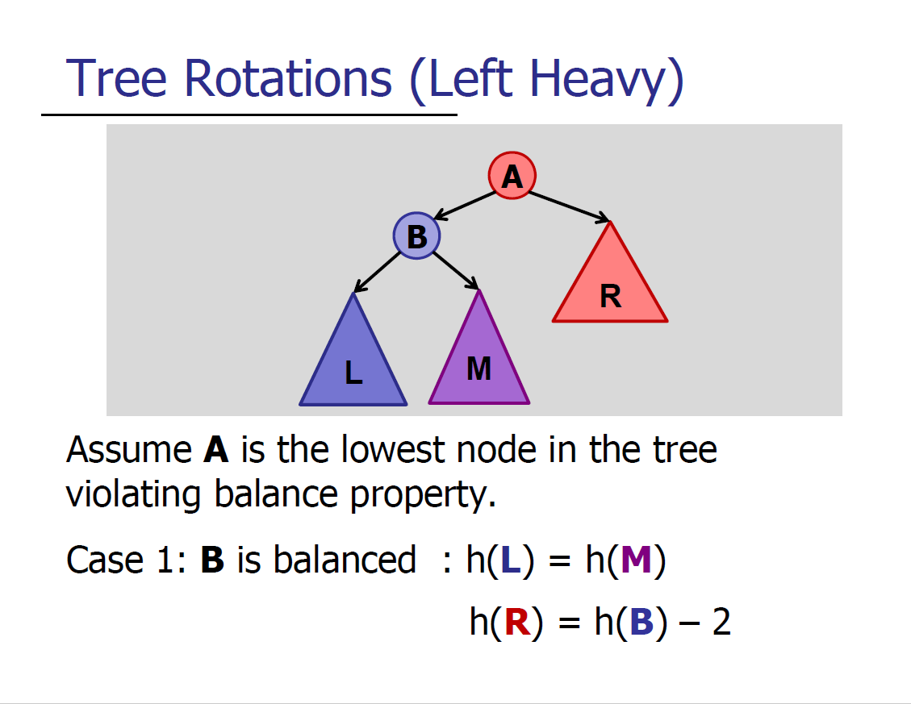

Slide 174
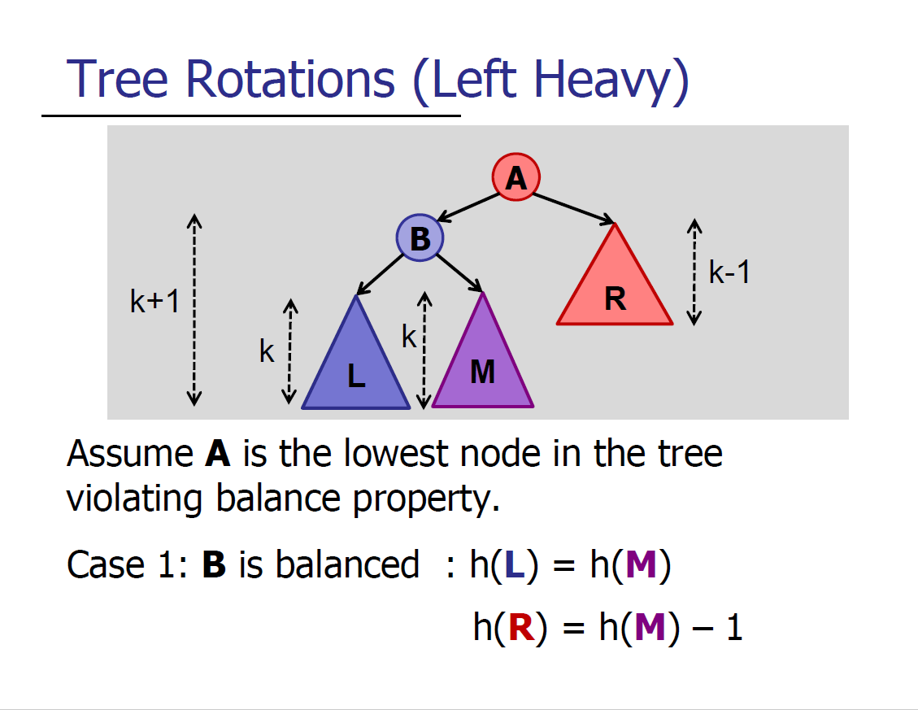

Slide 175
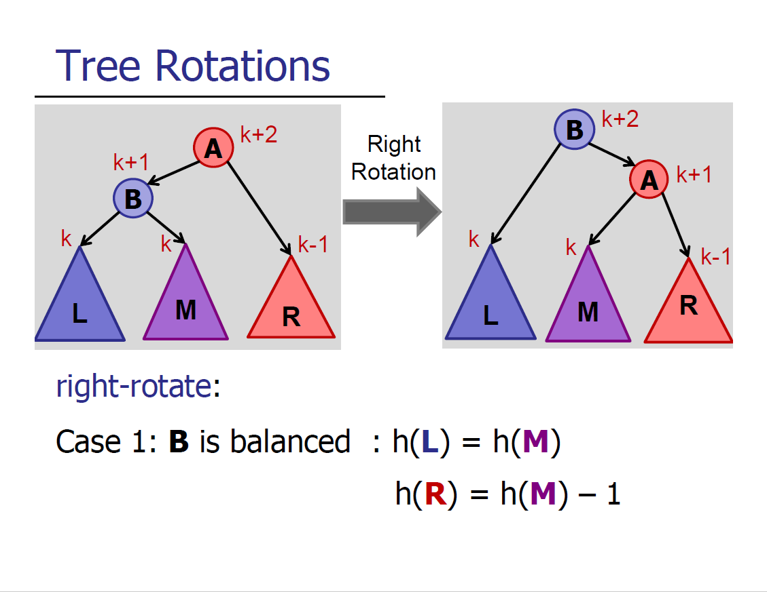

Slide 176
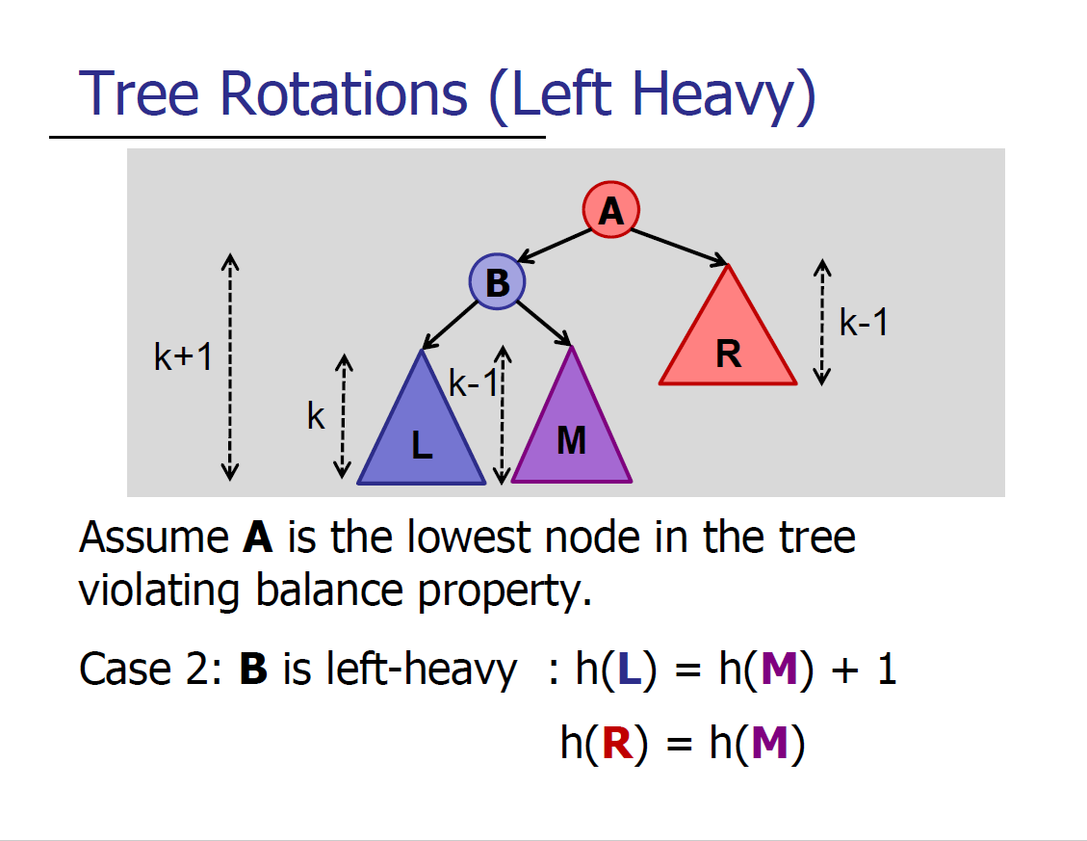

Slide 177
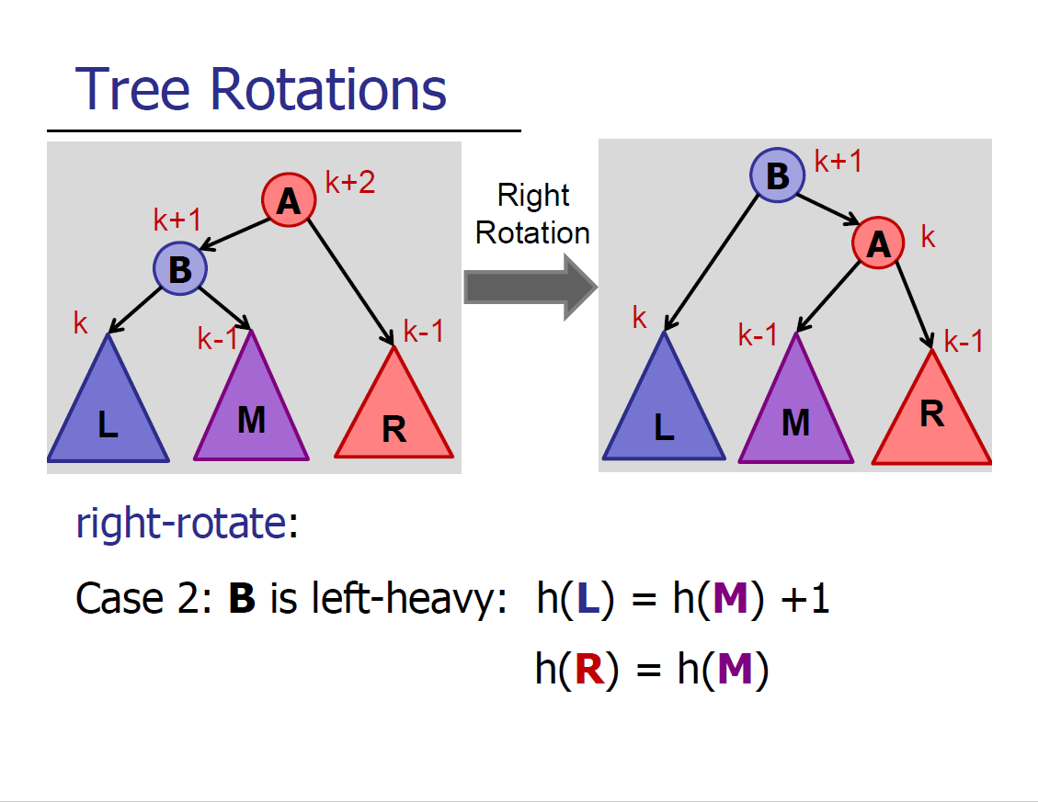

Slide 178


Slide 179
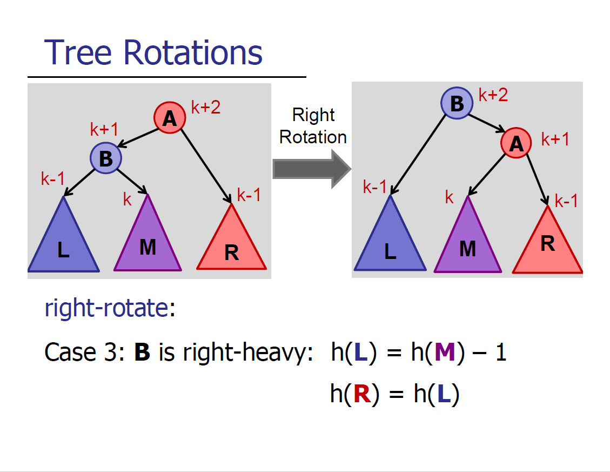

Slide 180
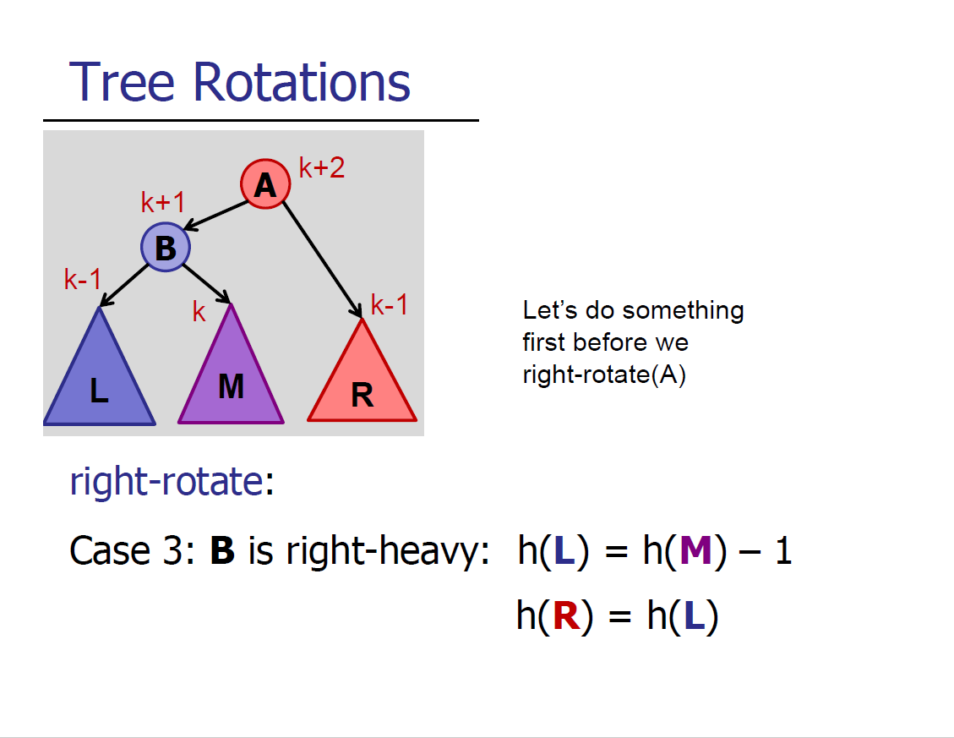

Slide 181
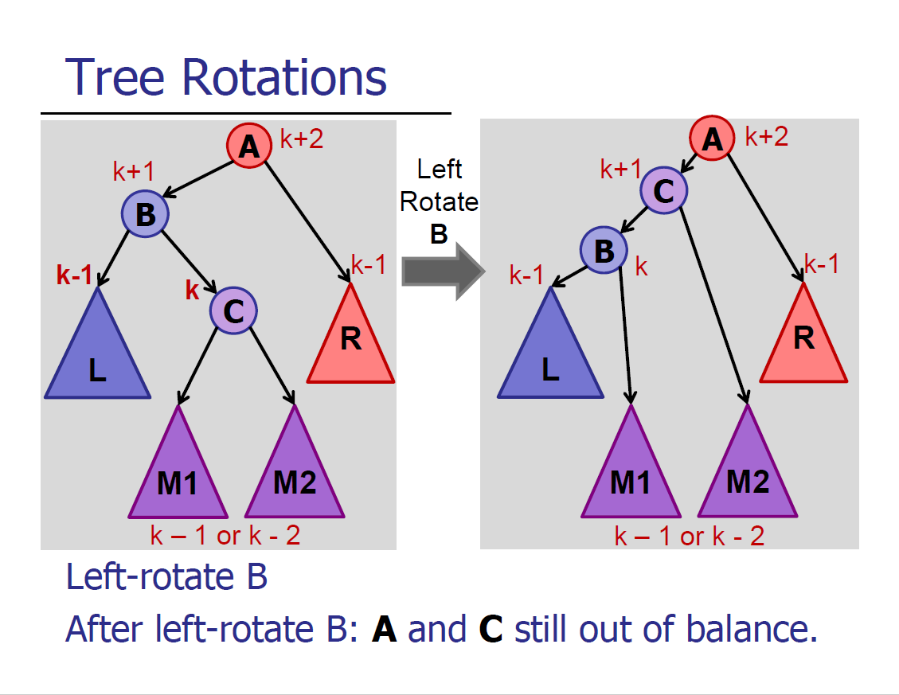

Slide 182
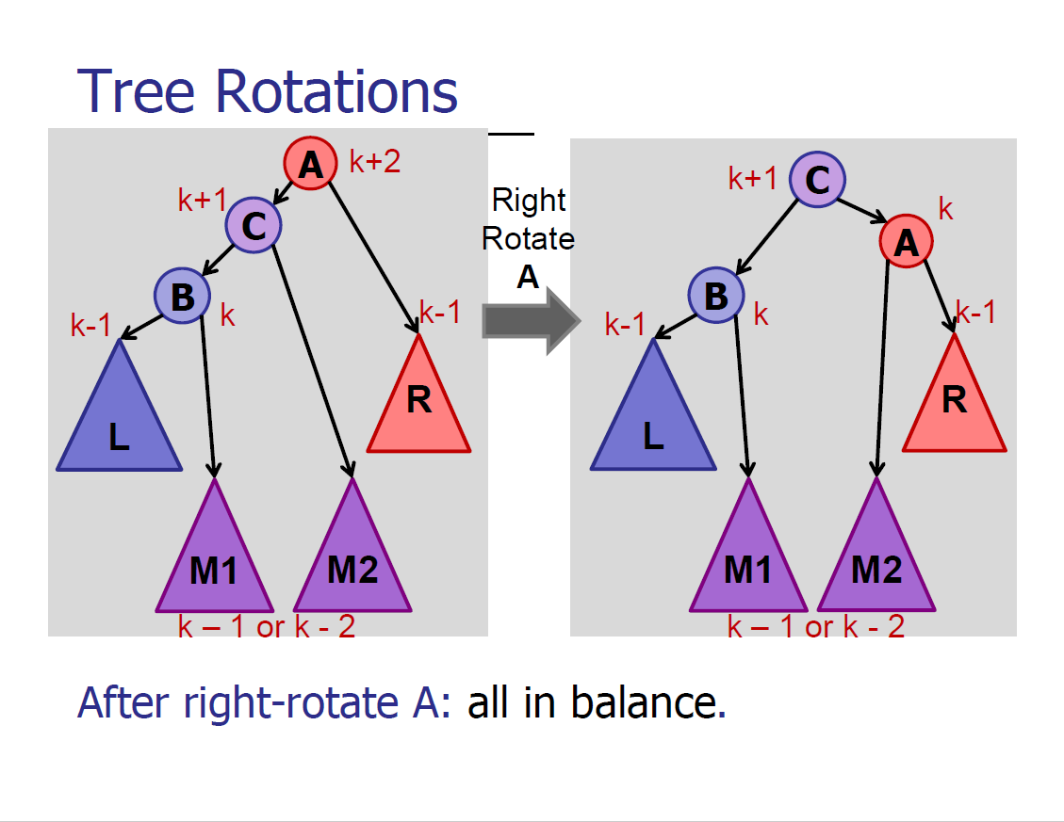

Slide 183
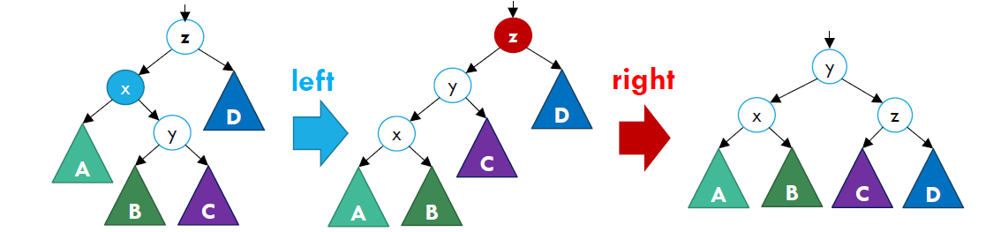
How is height affected after rotation?
The goal of rotation is to fix height imbalances!
Height should either decrease by 1 or remain the same (peek double rotation)
Height remain the same for root
Height decreases by 1

Slide 184
insert(8)
Where should 8 be inserted?
h = 3
34
h = 1
h = 2
5
233
13
89
610
55
144
377
987

Slide 185
insert(8)
Notice that the height increases for that particular subtree. How should we fix this imbalance?
h = 3
34
h = 2
h = 2
5
233
13
89
610
8
55
144
377
987

Slide 186
insert(8)
rightRotate(13)
h = 3
34
h = 2
h = 2
5
233
13
89
610
8
55
144
377
987

Slide 187
insert(8)
rightRotate(13)
h = 3
34
h = 2
h = 2
5
233
8
89
610
13
55
144
377
987

Slide 188
insert(8)
Notice the height didn’t change at all! Where should we perform the second rotation?
h = 3
34
h = 2
h = 2
5
233
8
89
610
13
55
144
377
987

Slide 189
insert(8)
leftRotate(5)
h = 3
34
h = 2
h = 2
5
233
8
89
610
13
55
144
377
987

Slide 190
insert(8)
leftRotate(5)
h = 3
34
h = 1
h = 2
8
233
5
13
89
610
55
144
377
987

Slide 191
insert(8)
Notice the height of the subtree goes back to 1! It was initially 1, then insertion caused it to become 2, but balancings fixed it back to 1
h = 3
34
h = 1
h = 2
8
233
5
13
89
610
55
144
377
987

Slide 192
delete(13)
What happens after this deletion?
34
5
233
2
13
89
610
3
55
144
377
987
999

Slide 193
delete(13)
Is there an imbalance?
34
5
233
2
89
610
3
55
144
377
987
999

Slide 194
delete(13)
Imbalance at 5!! wat do
34
5
233
2
89
610
3
55
144
377
987
999

Slide 195
delete(13)
leftRotate(2)
34
5
233
2
89
610
3
55
144
377
987
999

Slide 196
delete(13)
leftRotate(2)
34
5
233
3
89
610
2
55
144
377
987
999

Slide 197
delete(13)
rightRotate(5)
34
5
233
3
89
610
2
55
144
377
987
999

Slide 198
delete(13)
rightRotate(5)
34
3
233
2
5
89
610
55
144
377
987
999

Slide 199
delete(13)
Done???
34
3
233
2
5
89
610
55
144
377
987
999

Slide 200
delete(13)
Imbalance here!!! wat do
34
3
233
2
5
89
610
55
144
377
987
999

Slide 201
delete(13)
leftRotate(34)
34
3
233
2
5
89
610
55
144
377
987
999

Slide 202
delete(13)
leftRotate(34)
233
34
610
3
89
377
987
2
5
55
144
999

Slide 203
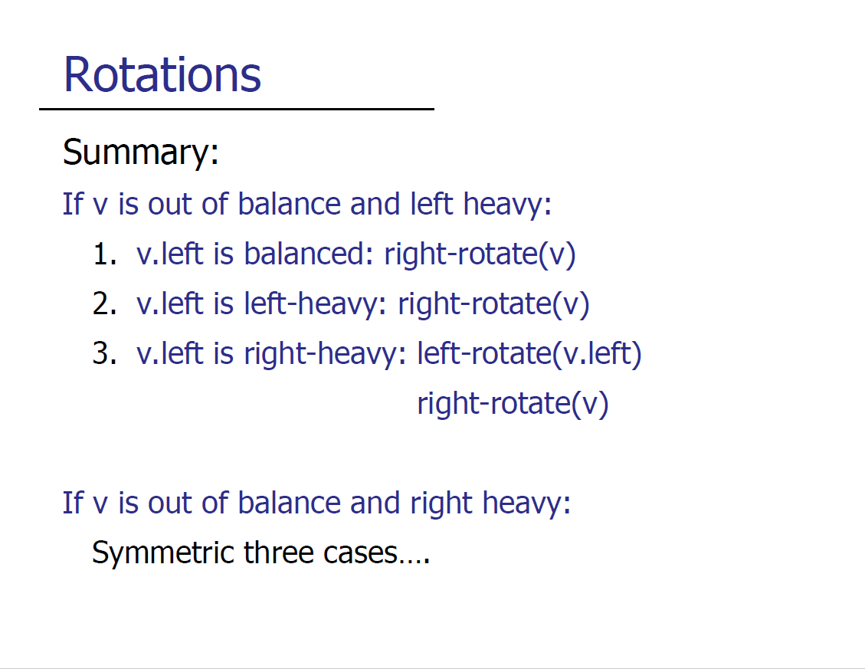

Slide 204
Number of rotations
For insert:
For delete:

Slide 205
Number of rotations
For insert: at most 2
For delete: O(logn), because you may have to rotate all the way up to the root

Slide 206
Tutorial Time
Slides for tutorials are taken and adapted from Ian

Slide 207
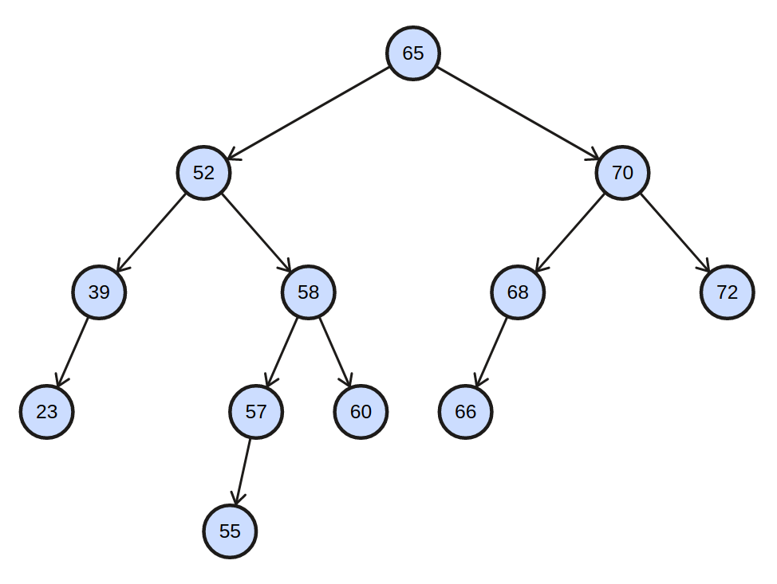
Problem 1: AVL Tree Review
Trace the deletion of the node with the key 70.

Slide 208
Problem 1: AVL Tree Review
First, find the successor of 70, which is 72.

Slide 209
Problem 1: AVL Tree Review
Copy the value of the successor over.
72

Slide 210
Problem 1: AVL Tree Review
Then, delete the successor.
72

Slide 211
Problem 1: AVL Tree Review
h = 4
Now, the subtree rooted at the node with key 72 is unbalanced!
h = 3
72
h = 2
h = 1
h = 2
h = 1
h = 0
h = 1
h = 0
h = 0
h = 0

Slide 212
Problem 1: AVL Tree Review
h = 4
Let the node with key 72 be v.
h = 3
72
h = 2
h = 1
h = 2
h = 1
h = 0
h = 1
h = 0
h = 0
h = 0

Slide 213
Problem 1: AVL Tree Review
h = 4
Let the node with key 72 be v.
v is out of balance and left heavy.
h = 3
72
h = 2
h = 1
h = 2
h = 1
h = 0
h = 1
h = 0
h = 0
h = 0

Slide 214
Problem 1: AVL Tree Review
h = 4
Let the node with key 72 be v.
v is out of balance and left heavy.
v.left is left heavy.
h = 3
72
h = 2
h = 1
h = 2
h = 1
h = 0
h = 1
h = 0
h = 0
h = 0

Slide 215
Problem 1: AVL Tree Review
h = 4
Let the node with key 72 be v.
v is out of balance and left heavy.
v.left is left heavy.
Perform a right rotation on v!
h = 3
72
h = 2
h = 1
h = 2
h = 1
h = 0
h = 1
h = 0
h = 0
h = 0

Slide 216
Problem 1: AVL Tree Review
h = 4
Let the node with key 72 be v.
v is out of balance and left heavy.
v.left is left heavy.
Perform a right rotation on v!
h = 3
68
h = 1
h = 1
h = 2
66
h = 0
h = 0
h = 0
h = 1
h = 0
h = 0

Slide 217
Problem 1: AVL Tree Review
h = 4
Now, the subtree rooted at the node with key 65 is unbalanced.
h = 3
68
h = 1
h = 1
h = 2
66
h = 0
h = 0
h = 0
h = 1
h = 0
h = 0

Slide 218
Problem 1: AVL Tree Review
h = 4
Let the node with key 65 be v.
h = 3
68
h = 1
h = 1
h = 2
66
h = 0
h = 0
h = 0
h = 1
h = 0
h = 0

Slide 219
Problem 1: AVL Tree Review
h = 4
Let the node with key 65 be v.
v is out of balance and left heavy.
h = 3
68
h = 1
h = 1
h = 2
66
h = 0
h = 0
h = 0
h = 1
h = 0
h = 0

Slide 220
Problem 1: AVL Tree Review
h = 4
Let the node with key 65 be v.
v is out of balance and left heavy.
v.left is right heavy.
h = 3
68
h = 1
h = 1
h = 2
66
h = 0
h = 0
h = 0
h = 1
h = 0
h = 0

Slide 221
Problem 1: AVL Tree Review
h = 4
Let the node with key 65 be v.
v is out of balance and left heavy.
v.left is right heavy.
Perform a left rotation on v.left, then a right rotation on v!
h = 3
68
h = 1
h = 1
h = 2
66
h = 0
h = 0
h = 0
h = 1
h = 0
h = 0

Slide 222
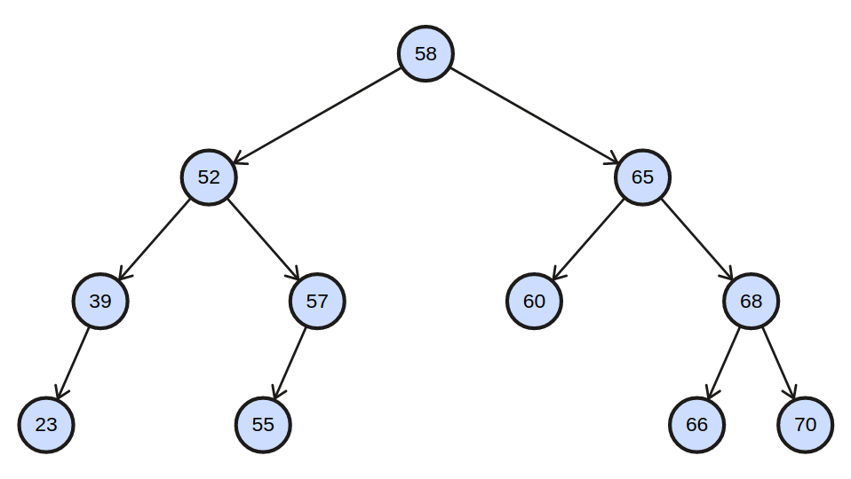
Problem 1: AVL Tree Review
h = 3
Let the node with key 65 be v.
v is out of balance and left heavy.
v.left is right heavy.
Perform a left rotation on v.left, then a right rotation on v!
h = 2
h = 2
h = 1
h = 1
h = 0
h = 1
h = 0
h = 0
h = 0
72
h = 0

Slide 223
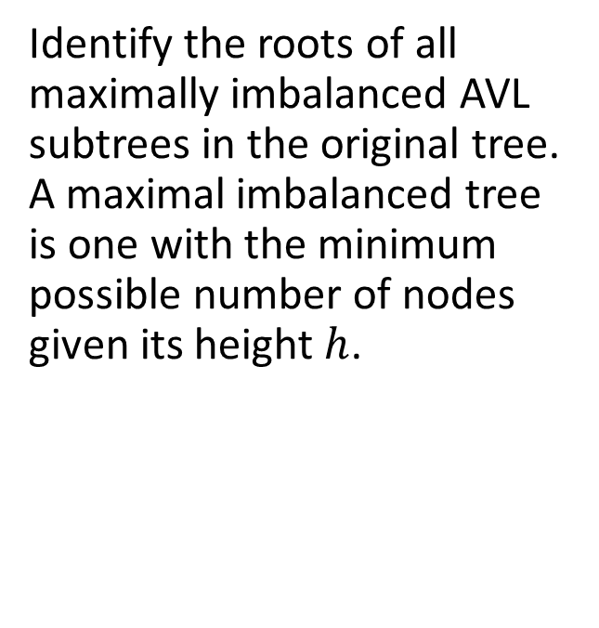
Problem 1: AVL Tree Review

Slide 224
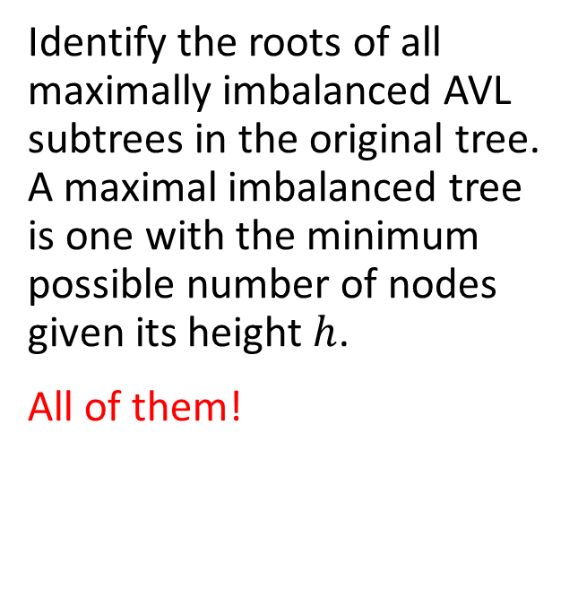
Problem 1: AVL Tree Review

Slide 225
Problem 1: AVL Tree Review
h = 4
h = 3
72
h = 2
h = 1
h = 2
h = 1
h = 0
h = 0
h = 1
h = 0
h = 0
h = 0

Slide 226
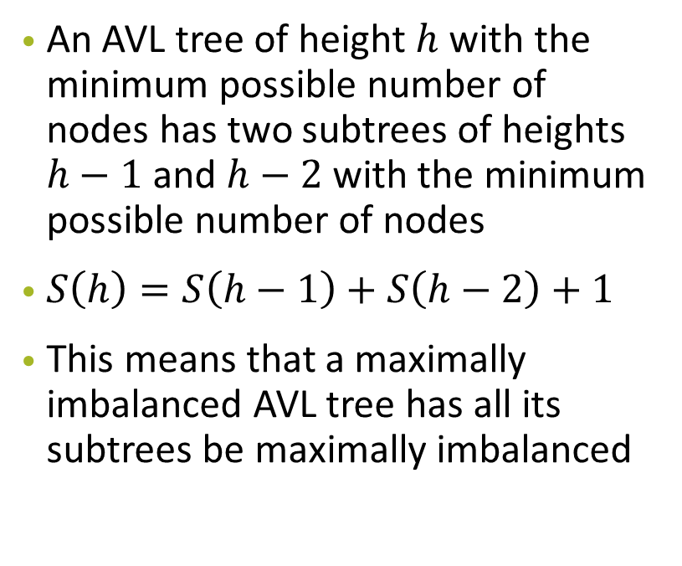
Problem 1: AVL Tree Review
h = 4
h = 3
72
h = 2
h = 1
h = 2
h = 1
h = 0
h = 0
h = 1
h = 0
h = 0
h = 0

Slide 227
Lecture 1: AVL Tree Review
During lectures, we’ve learnt that we need to store and maintain height information for each AVL tree node to determine if there is a need to rebalance the AVL tree during insertion and deletion. However, if we store height as an int, each tree node now requires 32 extra bits. Can you think of a way to reduce the extra space required for each node to 2 bits instead?

Slide 228
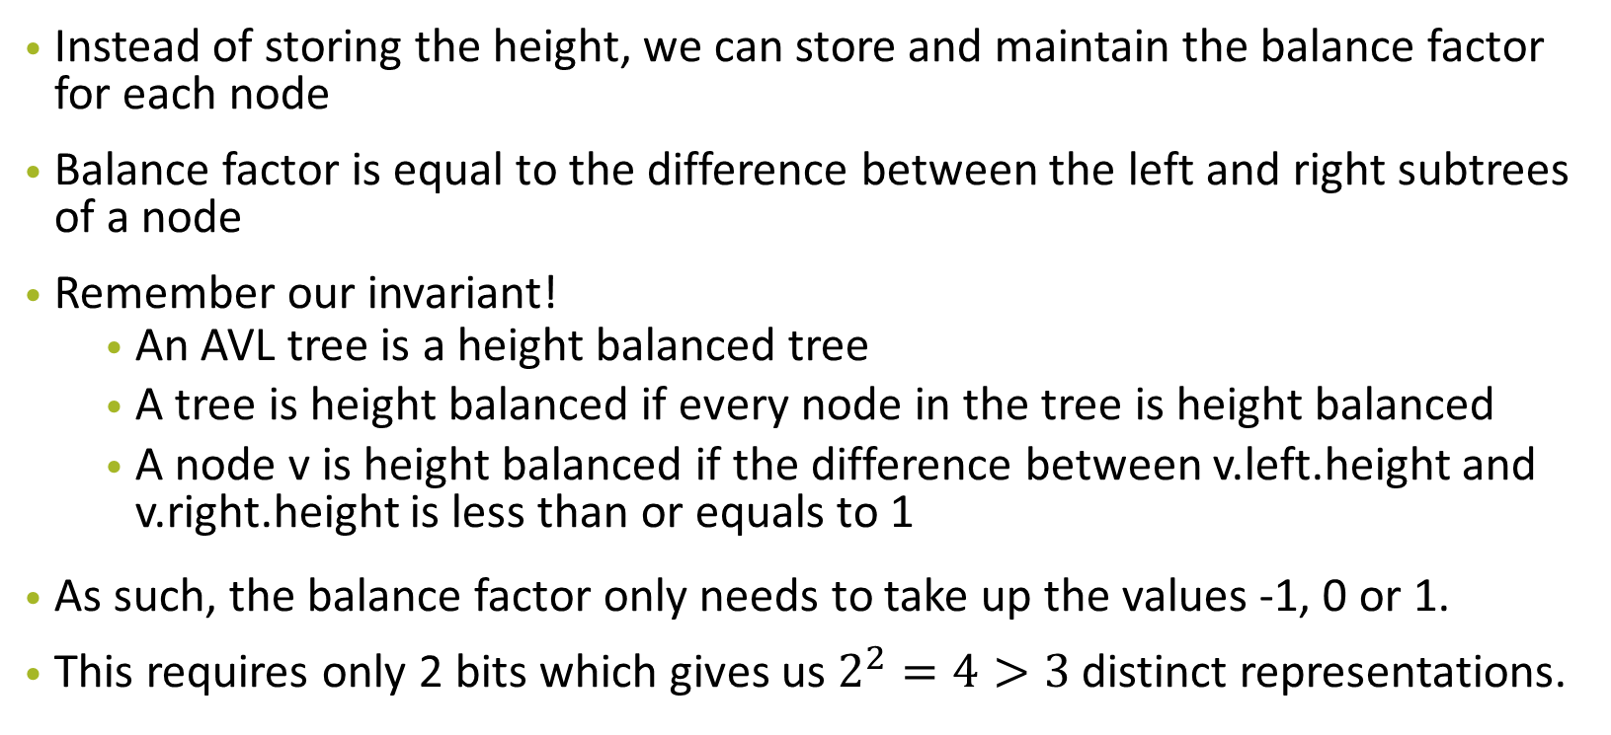
Lecture 1: AVL Tree Review

Slide 229
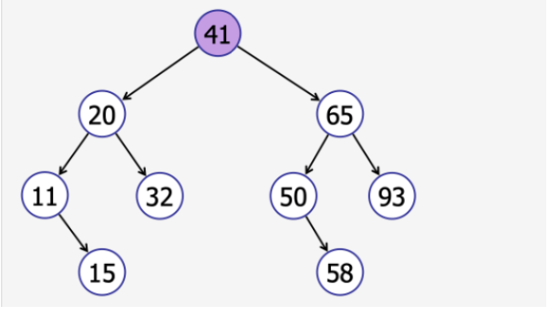
Problem 1: AVL Tree Review
Given a pre-order traversal result of a binary search tree T, suggest an algorithm to reconstruct the original tree T.
Sequence: 41, 20, 11, 15, 32, 65, 50, 58, 93

Slide 230
Problem 1: AVL Tree Review
Given a sequence A[1..n], the algorithm of reconstuction is given as,
Set the key of root to be first element(i.e A[1])
Found the position of the first element less than this value(noted as idx1), and the position of the first element larger than this value(noted as idx2)
recurse on both A[idx1...(idx2 − 1)] and A[idx2...n] to have two BST
Set the left child of root to be BST returned from first sequence and right child to be BST returned from the second sequence
Sequence: 41, 20, 11, 15, 32, 65, 50, 58, 93

Slide 231
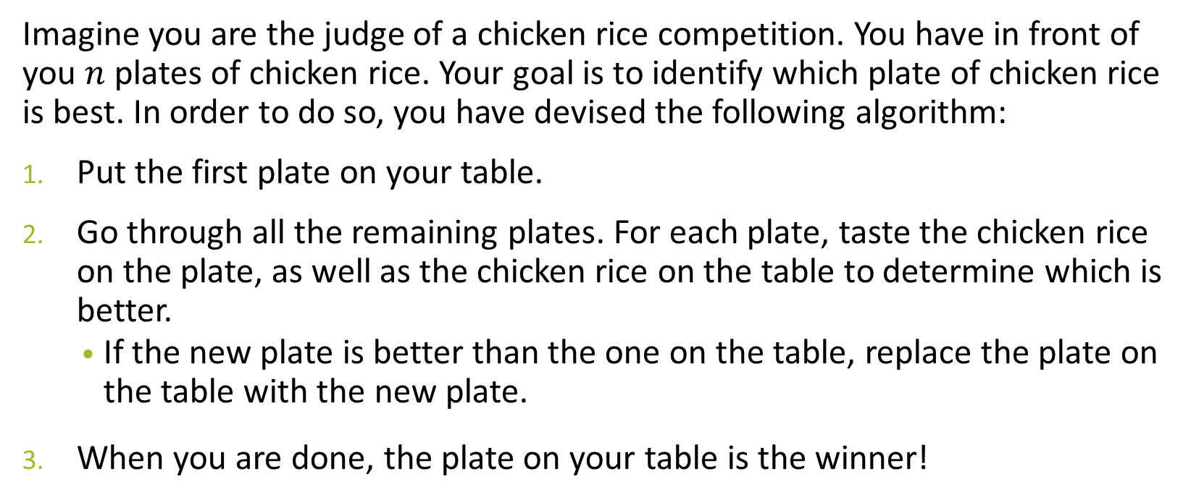
Problem 2a: Chicken Rice

Slide 232
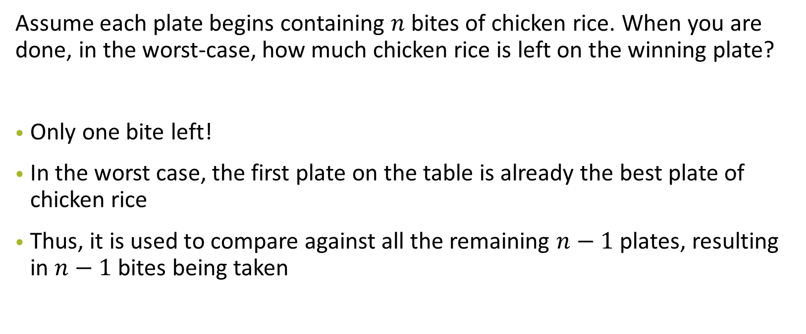
Problem 2a: Chicken Rice

Slide 233
Problem 2b: Chicken Rice
Oh no! We want to make sure that there is as much chicken rice left on the winning plate as possible (so you can take it home and give it to all your friends). Design an algorithm to maximise the amount of remaining chicken rice on the winning plate, once you have completed the testing/tasting process.
How much chicken rice is left on the winning plate?
How much chicken rice have you had to consume in total?
Give a tight asymptotic bound for both questions above.

Slide 234
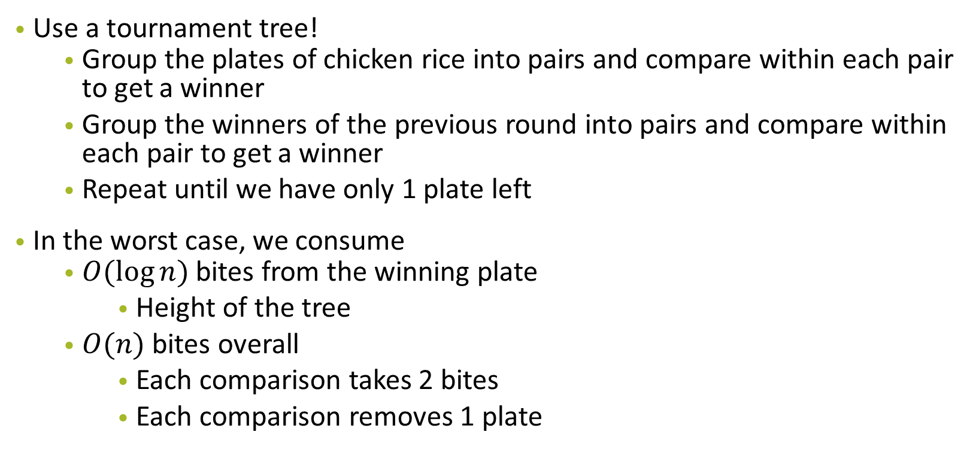
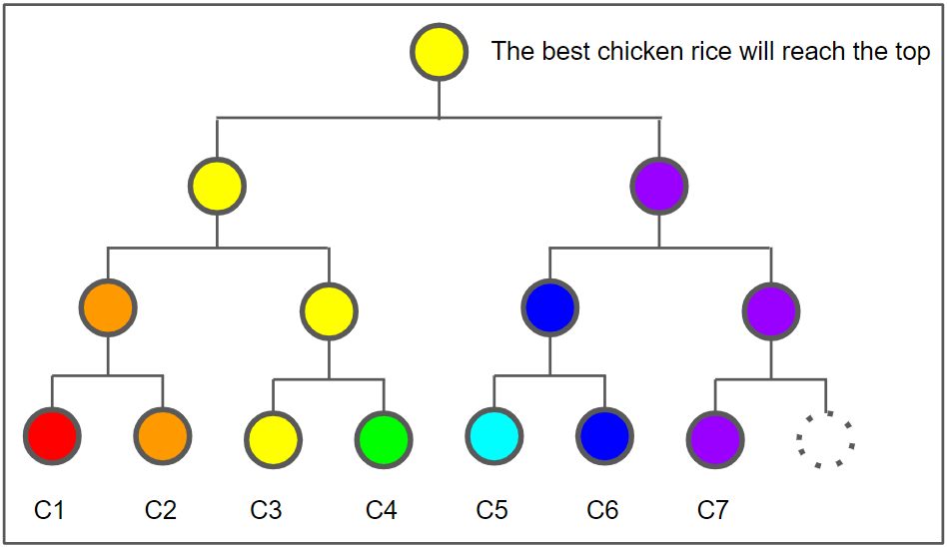
Problem 2b: Chicken Rice

Slide 235
Problem 2c: Chicken Rice
Now, I do not want to find the best chicken rice, but the median chicken rice. Again, design an algorithm to maximise the amount of remaining chicken rice on the median plate once you have completed the testing/tasting process.
How much chicken rice is left on median plate?
How much chicken rice have you had to consume in total?
Give a tight asymptotic bound for both questions above. If your algorithm is randomised, give your answers in expectation.

Slide 236
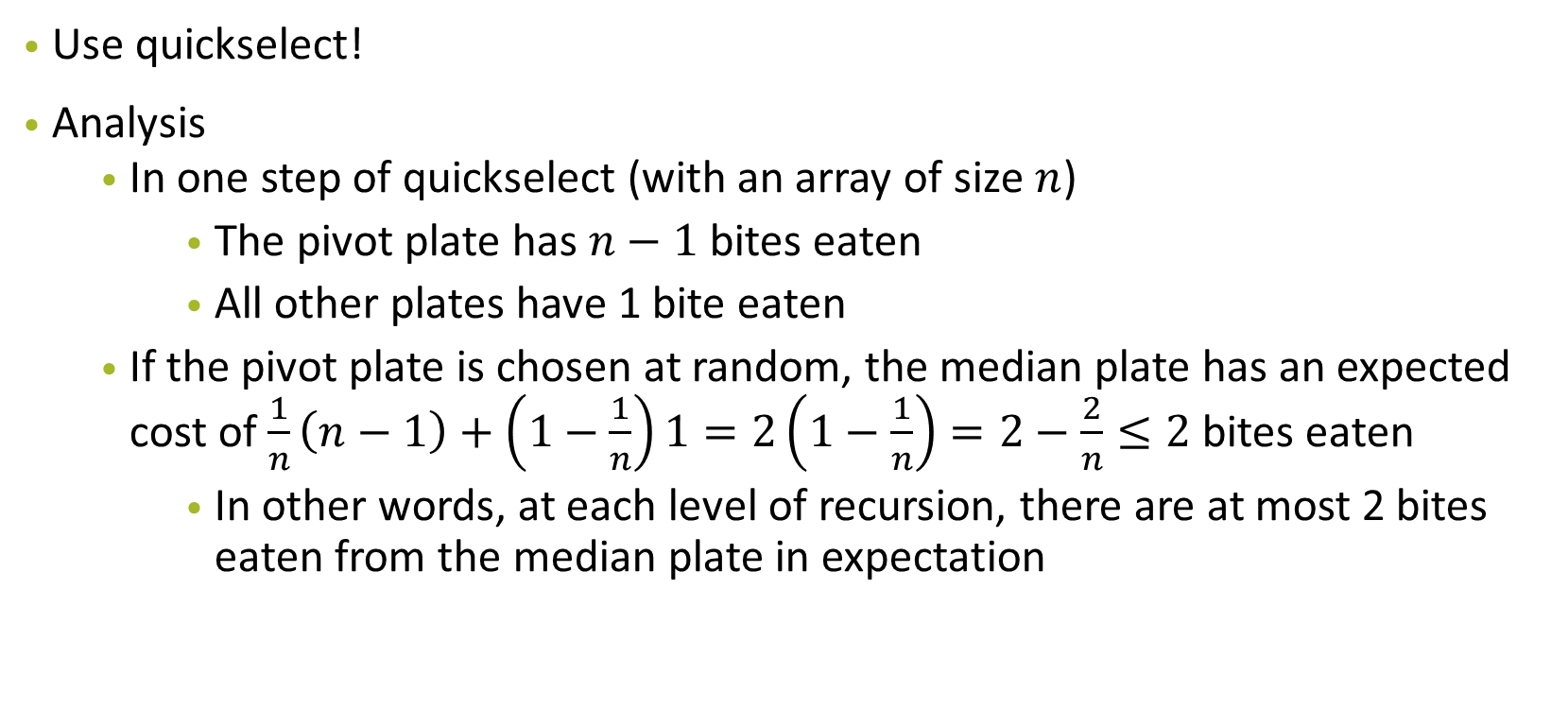
Problem 2c: Chicken Rice

Slide 237
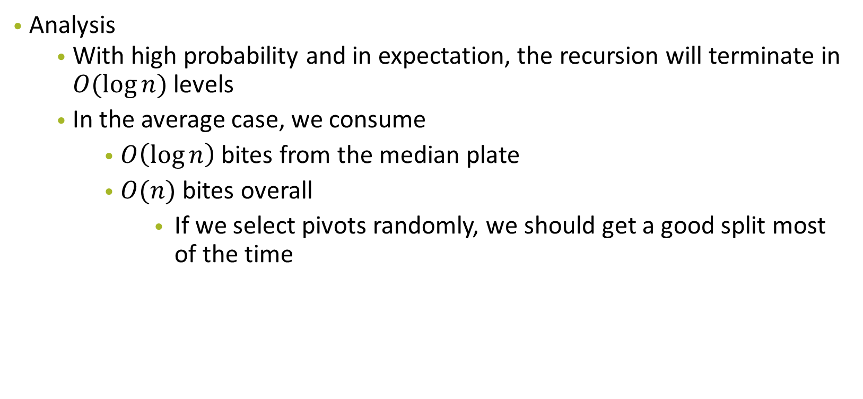
Problem 2c: Chicken Rice

Slide 238
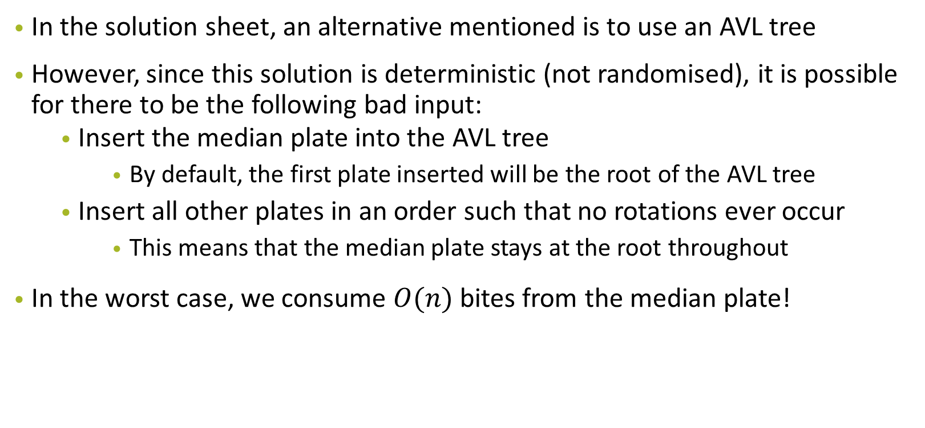
Problem 2c: Chicken Rice

Slide 239
Problem 3: Economic Research

Slide 240
Problem 3: Economic Research
Main Question Idea: You want to divide the dataset into “equi-wealth” age ranges, and given parameter k, you should output k different lists A₁, A₂, ..., A_{k} with the following properties:
All the ages of people in set A_{j} should be less than or equal to the ages of people in A_{j+1}. That is, each set should be a subset of the original dataset containing a contiguous age range.
The sum of wealth in each set should be (roughly) the same

Slide 241
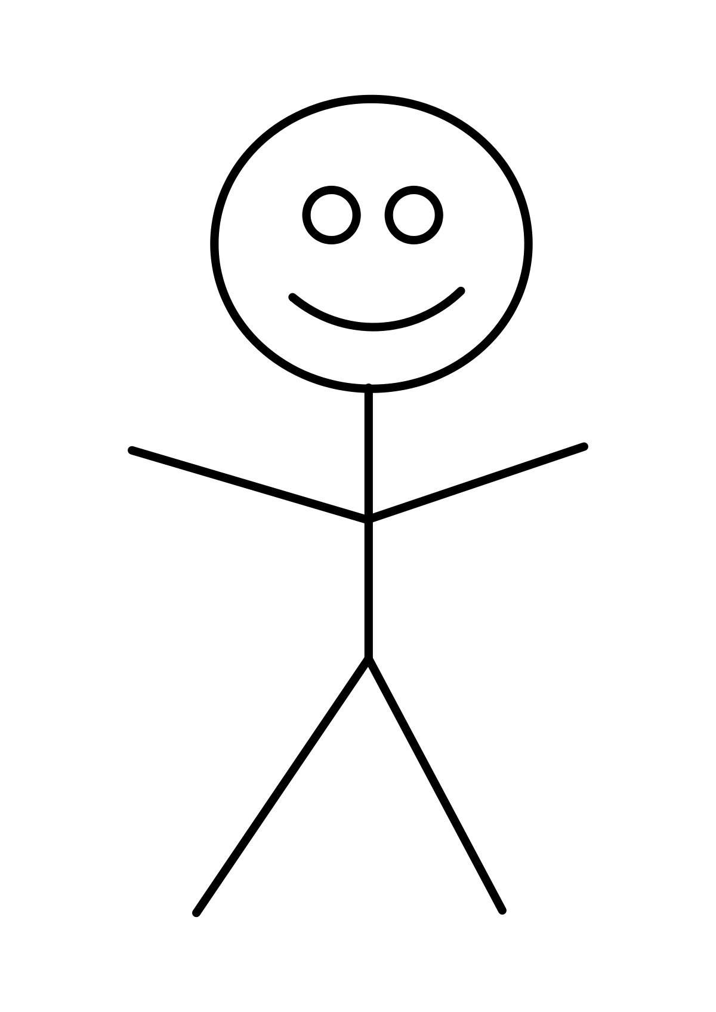
Problem 3: Example
18 yo, wealth: 1,000
24 yo, wealth: 150,000
32 yo, wealth: 42,000
60 yo, wealth: 109,000
78 yo, wealth: 151,000

Slide 242
Problem 3: Example
18 yo, wealth: 1,000
24 yo, wealth: 150,000
32 yo, wealth: 42,000
60 yo, wealth: 109,000
78 yo, wealth: 151,000
Equi-wealth partition: 151,000

Slide 243
Problem 3: Economic Research
Design the most eﬀicient algorithm you can to solve this problem/do the partition, and analyse its time complexity.

Slide 244
Problem 3: Economic Research
Feeling lost?
Try to model this question to similar problems/algorithms you have seen before!

Slide 245
Problem 3: Economic Research
Order Statistics?

Slide 246
Problem 3: Economic Research
Order Statistics?
We are trying to find the 1/k, 2/k , … , (k−1)/k order statistics of the weighted sum!

Slide 247
Problem 3: Economic Research
First and foremost, we would need to find the equi-wealth partition
24 yo, wealth: 150,000
32 yo, wealth: 42,000
18 yo, wealth: 1,000
78 yo, wealth: 151,000
60 yo, wealth: 109,000
Equi-wealth partition: 151,000

Slide 248
Problem 3: Economic Research
First and foremost, we would need to find the equi-wealth partition
24 yo, wealth: 150,000
32 yo, wealth: 42,000
18 yo, wealth: 1,000
78 yo, wealth: 151,000
60 yo, wealth: 109,000
Go through everyone to find total wealth of the population, and divide by k

Slide 249
Problem 3: Economic Research
Next, we want to find the smallest ages with total wealth of at most 151,000
24 yo, wealth: 150,000
32 yo, wealth: 42,000
18 yo, wealth: 1,000
78 yo, wealth: 151,000
60 yo, wealth: 109,000
REMEMBER: this is not sorted! So what algorithm can we use?

Slide 250
Problem 3: Economic Research
1. Use QuickSelect to find median based on age, and then partition around the median to find the first target (1/k)
24 yo, wealth: 150,000
18 yo, wealth: 1,000
32 yo, wealth: 42,000
78 yo, wealth: 151,000
60 yo, wealth: 109,000
This is the median

Slide 251
Problem 3: Economic Research
2. Sum the totals on the left and right halves, and decide on which side to recurse on. (If target < median, recurse on the left. If target > medium, then target = target - total wealth of the left half.)
24 yo, wealth: 150,000
18 yo, wealth: 1,000
32 yo, wealth: 42,000
78 yo, wealth: 151,000
60 yo, wealth: 109,000
Left sum: 151,000
This is the median
Right sum: 260,000

Slide 252
Problem 3: Economic Research
2. Here, there is no need to recurse to the left anymore, since you know the partition is between the 18 and 32 yo.
24 yo, wealth: 150,000
18 yo, wealth: 1,000
32 yo, wealth: 42,000
78 yo, wealth: 151,000
60 yo, wealth: 109,000
Left sum: 151,000
This is the median
Right sum: 260,000

Slide 253
Problem 3: Economic Research
3. Repeat for the k - 1 targets (2/k, 3/k, … (k-1)/ k
24 yo, wealth: 150,000
18 yo, wealth: 1,000
32 yo, wealth: 42,000
78 yo, wealth: 151,000
60 yo, wealth: 109,000
Left sum: 151,000
This is the median
Right sum: 260,000

Slide 254
Problem 3: Economic Research
Each QuickSelect: O(n)

Slide 255
Problem 3: Economic Research
Each QuickSelect: O(n)
Total time taken for k targets: O(nk)

Slide 256
Problem 3: Economic Research
Modifications?

Slide 257
Problem 3: Economic Research
Modifications
Can use random pivot instead of median

Slide 258
Problem 3: Economic Research
Modifications
Can use random pivot instead of median
Can find all k “breakpoints” at once → less repeated work done partitioning the array

Slide 259
Problem 3: Economic Research
Modifications
Can use random pivot instead of median
Can find all k “breakpoints” at once → less repeated work done partitioning the array
Runtime?

Slide 260
Problem 3: Economic Research
Analysing runtime of more efficient method:
1. First divide the array up into k equal sized parts (in terms of the number of elements) by running QuickSort for log(k) levels of recursion.
Each level divides the array in half, so at this point, you have k different equal sized pieces → O(n log k) time
1 … n/k
n/k+1…2n/k
…
n - k…n

Slide 261
Problem 3: Economic Research
Analysing runtime of more efficient method:
2. For each of the k targets, figure out which piece it is in by:
1. summing the wealth in each equally sized part → O(n)
2. binary search k times for which of the k pieces it belongs to → O(k log k)
1 … n/k
n/k+1…2n/k
…
n - k…n
1st target is inside
2nd & 3rd target in inside

Slide 262
Problem 3: Economic Research
Analysing runtime of more efficient method:
3.Now run the initial algorithm for each target on the correct subarray of size O(n/k), which takes O(n/k) time each. Since there are k targets, the total time will be O(n).
Initial algorithm:
Use QuickSelect to find the median based on age, and then partition around the median.
Sum the totals on the left and right halves, and decide on which side to recurse on.
If target is on the left, simply recurse on the left.
If your target is on the right, then subtract from your target the total wealth of the left half.
1 … n/k
n/k+1…2n/k
…
n - k…n

Slide 263
Problem 3: Economic Research
Analysing runtime of more efficient method:
Recurrence Relation:
T(n, k) = O(n) + O(k) + T(n/2, k₁) + T(n/2, k₂) where k₁ + k₂ = k
At each level:
O(n) to partition the array into left and right using a pivot (QuickSelect)
O(k) to decide for each target if it is in the left and right halves
T(...) parts are for the two recursive calls

Slide 264
Problem 3: Economic Research
Modifications
Can use random pivot instead of median
Can find all k “breakpoints” at once → less repeated work done partitioning the array
Runtime? O(n log k)

Slide 265
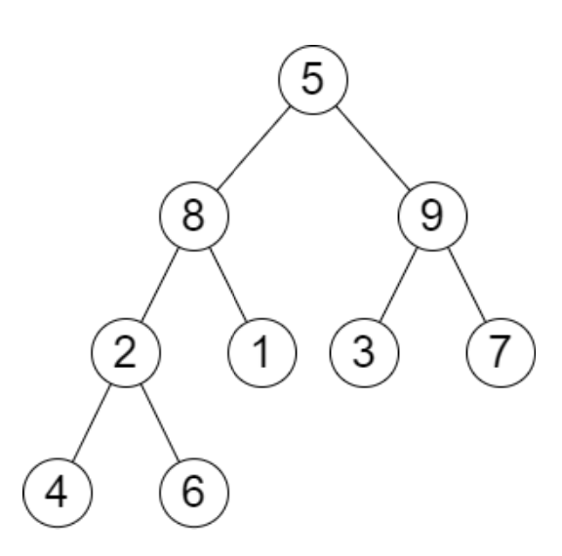
Problem 5: Height of Binary Tree after Subtree removal queries
You are given the root of a binary tree with n nodes. Each node is assigned a unique value from 1 to n. You are also given an array of queries of size m.
Remove the subtree rooted at queries[i] and return the height of the tree in answer[i].
Example
Input: root = [5,8,9,2,1,3,7,4,6], queries = [3,2,4,8]
Output: [3,2,3,2]

Slide 266
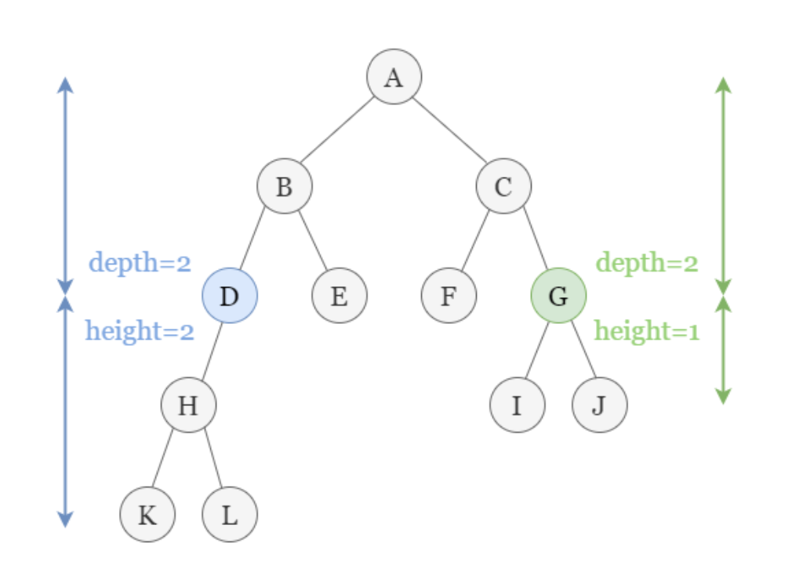
Problem 5: Height of Binary Tree after Subtree removal queries
Before answering the question, define 2 terms:
Depth
Height
Depth of a node = number of edges from root to node
Height of a node = number of edges in the longest path from the given node to some node(leaf) in the subtree rooted at that node.

Slide 267
Problem 5: Height of Binary Tree after Subtree removal queries
Solution: Preprocess the tree to find the remaining height after subtree removal of each node and store it in the node.
Compute the height and depth of each node.
Height -> in-order traversal
Depth -> DFS
Time complexity ?

Slide 268
Problem 5: Height of Binary Tree after Subtree removal queries
Solution: Preprocess the tree to find the remaining height after subtree removal of each node and store it in the node.
Compute the height and depth of each node.
Height -> in-order traversal
Depth -> DFS
Time complexity ? O(n) for both operations

Slide 269
Problem 5: Height of Binary Tree after Subtree removal queries
When removing a subtree rooted at node D, look at all other nodes with same depth, d₀
as D. Find the maximum height h₀ of all other remaining nodes and sum with d₀ to get final result.
Iterating the nodes in in-order traversal, we can group all the nodes by their depth (O(logn) each)
And find the 2 nodes with maximum height among each group.(Why?)
Because we are only interested in maximum height after subtree removal, it is either maximum height or 2nd maximum height.
This process:O(n log n)

Slide 270
Problem 5: Height of Binary Tree after Subtree removal queries
Then, construct a tree with key being original index and value being the result(height after removing that node)
O(n log n) to create such a tree.
Then, to answer each query, O(m log n)
Total time complexity: O(n log n + m log n)

Slide 271
Problem 4: Order Maintenance
Design a data structure for Order Maintenance. The goal here is to maintain a total order over some arbitrary objects. The data structure supports two operations:
InsertBefore(A, B): insert B immediately before A
InsertAfter(A, B): insert B immediately after A.
IsAfter(A, B): is B after A in the total order?
Note: InsertAfter(A, B) adds B immediately after A, while the query operation IsAfter(A, B) asks whether B is anywhere after A in the total order

Slide 272
Problem 4: Order Maintenance
Expected time complexity of each operation is O(log n), where n is the number of items in the data structure.

Slide 273
Problem 4: Order Maintenance
Expected time complexity of each operation is O(log n), where n is the number of items in the data structure.
Hint: Which data structure has a time complexity of O(log n) for each operation?

Slide 274
Problem 4: Order Maintenance
AVL Trees!

Slide 275
Problem 4: Order Maintenance
InsertAfter(A, B):
If A has no right child, then insert B as the right child of A.

Slide 276
Problem 4: Order Maintenance
InsertAfter(A, B):
If A has no right child, then insert B as the right child of A.
Otherwise, find the successor of A and insert B as the left child of the successor.

Slide 277
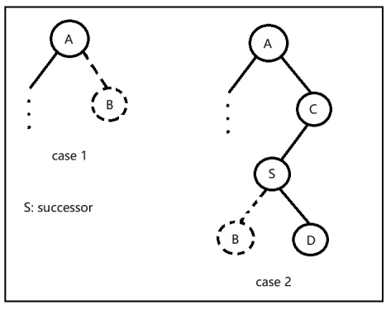
Problem 4: Order Maintenance
InsertAfter(A, B):
If A has no right child, then insert B as the right child of A.
Otherwise, find the successor of A and insert B as the left child of the successor.

Slide 278
Problem 4: Order Maintenance
InsertBefore(A, B):
When inserting B before A, do the same thing in reverse:
Insert B as the left child (if none exists)
Insert B as the right child of the predecessor of A.

Slide 279
Problem 4: Order Maintenance
IsAfter(A, B):

Slide 280
Problem 4: Order Maintenance
IsAfter(A, B):
Walk up the tree to root from A and B (i.e. when their paths “meet”)

Slide 281
Problem 4: Order Maintenance
IsAfter(A, B):
Walk up the tree to root from A and B (i.e. when their paths “meet”)
Will need to store each step along the path (in an array), the key and whether the node was entered from the left or right.

Slide 282
Problem 4: Order Maintenance
IsAfter(A, B):
Walk up the tree to root from A and B (i.e. when their paths “meet”)
Will need to store each step along the path (in an array), the key and whether the node was entered from the left or right.
Compare the two tree walks and find the common ancestor where one path entered from the left and the other from the right.

Slide 283
Problem 4: Order Maintenance
Cost of all operations:

Slide 284
Problem 4: Order Maintenance
Cost of all operations: O(log n), since the height of an AVL tree of n nodes is at most O(log n)

Slide 285
Problem 5: Ancestor Queries
Our job is now to simulate a binary tree. Each node has zero, one, or two children, and the tree is of height h. Unfortunately, it is not a balanced tree. By preprocessing the binary tree, design and implement an auxiliary data structure to support the following operations eﬀiciently:
InsertLeft(x, y): insert y as a left child of x in the binary tree.
InsertRight(x, y): insert y as a right child of x in the binary tree.
IsAncestor(x, y): is x an ancestor of y in the binary tree that contains them?

Slide 286
Problem 5: Ancestor Queries
Hint: Think about how you answer the IsAncestor(x, y) query without the extra data structure. What would the cost of that operation be? How can you improve this?

Slide 287
Problem 5: Ancestor Queries
Change way of traversal?

Slide 288
Problem 5: Ancestor Queries
New type of traversal in which each node in the tree appears twice:
Once before all of its children and once after all of its children.
For a node v with children y and z, we define traverse(v) recursively as follows:
print(v) traverse(y) traverse(z) print(v)

Slide 289
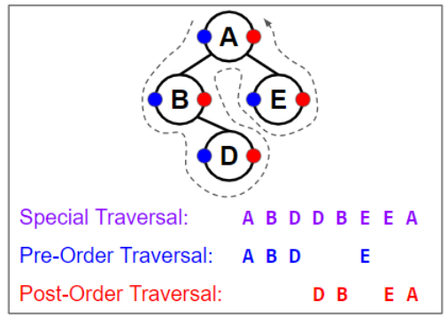
Problem 5: Ancestor Queries
For a node v with children y and z, we define traverse(v) recursively as follows:
print(v) traverse(y) traverse(z) print(v)

Slide 290
Problem 5: Ancestor Queries
For a node v with children y and z, we define traverse(v) recursively as follows:
print(v) traverse(y) traverse(z) print(v)
If v has no children, then its traversal consists of just two elements: v v.

Slide 291
Problem 5: Ancestor Queries
Let’s consider the sequence that we obtain out of this traversal. We’ll call the first time a node is printed as start(v), and the second time end(v).

Slide 292
Problem 5: Ancestor Queries
Let’s consider the sequence that we obtain out of this traversal. We’ll call the first time a node is printed as start(v), and the second time end(v).
Focusing only on the first printings: resulting total order is exactly a pre-order traversal
Focusing only on the second printings, resulting total order is exactly a post-order traversal

Slide 293
Problem 5: Ancestor Queries
Given two nodes v and w, we observe that v comes before w in a pre-order traversal of the original (unbalanced) tree if start(v) comes before start(w) in the traversal.
Similarly, v comes before w in a post-order traversal of the original (unbalanced) tree if end(v) comes before end(w) in the traversal.

Slide 294
Problem 5: Ancestor Queries
IsAncestor(x,y):
Check whether x precedes y in the pre-order traversal and whether y precedes x in the post-order traversal.

Slide 295
Problem 5: Ancestor Queries
IsAncestor(x,y):
Check whether x precedes y in the pre-order traversal and whether y precedes x in the post-order traversal.
Lemma:
Node x is an ancestor of y if and only if x comes before y in a pre-order traversal and x comes after y in a post-order traversal.

Slide 296
Problem 5: Ancestor Queries
Lemma:
Node x is an ancestor of y if and only if x comes before y in a pre-order traversal and x comes after y in a post-order traversal.
Looking at BDDB here, B is an ancestor of D

Slide 297
Problem 5: Ancestor Queries
Insertions:
To insert a new node w as a child of x, we need to insert start(w) and end(w)

Slide 298
Problem 5: Ancestor Queries
Insertions:
To insert a new node w as a child of x, we need to insert start(w) and end(w)
If w is the only child of x, or w is the left child of x, then we insert start(w) after x and end(w) after start(w).
Otherwise, if w is the right child of x, then we insert end(w) immediately before end(x) and we insert start(w) immediately before end(w).

Slide 299
Problem 5: Ancestor Queries
So what kind of operations we need to support?

Slide 300
Problem 5: Ancestor Queries
So what kind of operations we need to support?
Given 2 items, we need to be able to check whether one is before the other, and also, we need to be able to insert items as either directly before or directly after them.

Slide 301
Problem 5: Ancestor Queries
So what kind of operations we need to support?
Given 2 items, we need to be able to check whether one is before the other, and also, we need to be able to insert items as either directly before or directly after them.
Exactly the previous question! Qn 4: Order Maintenance

Slide 302
Problem 5: Ancestor Queries
So what kind of operations we need to support?
Possibly maintain some additional index structures, e.g., a tree to translate the name of a node to its location in the new traverse data structure, and/or the name of a node to its location in the unbalanced binary tree. This tree would allow us to lookup x, find start(x) and end(x) in the tree, and use them to answer the IsAncestor(x,y) query.

